Slide 1
SESSION I LEVEL OF GRANULARITY - MATERIALS
Current scope note:
  This facet comprises types of physical substances that are constituents of material objects or are used in their construction, but whose individual substance is not a factor in the objects’ function (eg gold, water, bricks, etc.) The facet may include pure raw materials, processed or unprocessed, and also materials that have been modelled and are incorporated into objects. Their main attribute is that they cannot be individualized, that is, they cannot be distinct "units" with clear and distinct boundaries or roles in respect to other units of the same or different kind.
  (Version: 1.2.2 / Submission Date: 19.08.2019 / Submission Id: 2150)
BBT Curation Committee Annual Meeting Athens 13.11.2019

Slide 2
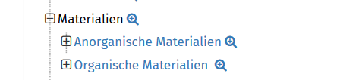
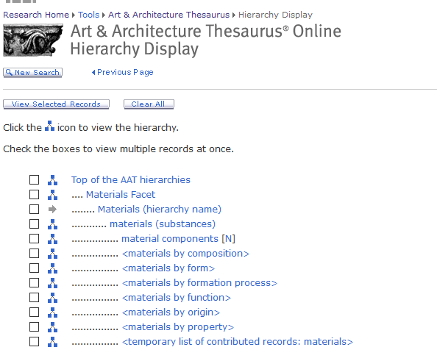
SESSION I LEVEL OF GRANULARITY - MATERIALS
Possible subdivisions:
Composition – organic / inorganic (DAI-Thesaurus‘ choice)
Form – liquid / solid / gas
„Source“ – animal / mineral (Object materials thesaurus – FISH Terminologies)
„Treatment“ – processed / non-processed
Guide terms (Getty AAT)
BBT Curation Committee Annual Meeting Athens 13.11.2019

Slide 3
SESSION I LEVEL OF GRANULARITY - MATERIALS
Current scope note:
  This facet comprises types of physical substances that are constituents of material objects or are used in their construction, but whose individual substance is not a factor in the objects’ function (eg gold, water, bricks, etc.) The facet may include pure raw materials, processed or unprocessed, and also materials that have been modelled and are incorporated into objects. Their main attribute is that they cannot be individualized, that is, they cannot be distinct "units" with clear and distinct boundaries or roles in respect to other units of the same or different kind.
  (Version: 1.2.2 / Submission Date: 19.08.2019 / Submission Id: 2150)
  What do „distinct roles“ mean in this respect?
BBT Curation Committee Annual Meeting Athens 13.11.2019

Slide 4

SESSION I LEVEL OF GRANULARITY – MOBILE OBJECTS
Current scope note:
  This term classifies material things that result from human endeavor, have aesthetic, cultural, historical, scientific, or other utilitarian value, and are by design or through collecting portable functional entities.
  (Version: 1.2.1 / Submission Date: 11.04.2019 / Submission Id: 2129)
BBT Curation Committee Annual Meeting Athens 13.11.2019

Slide 5
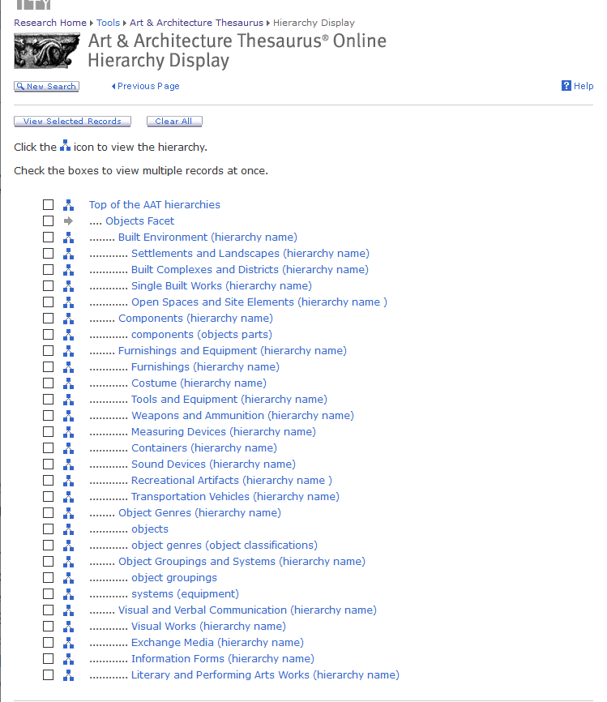
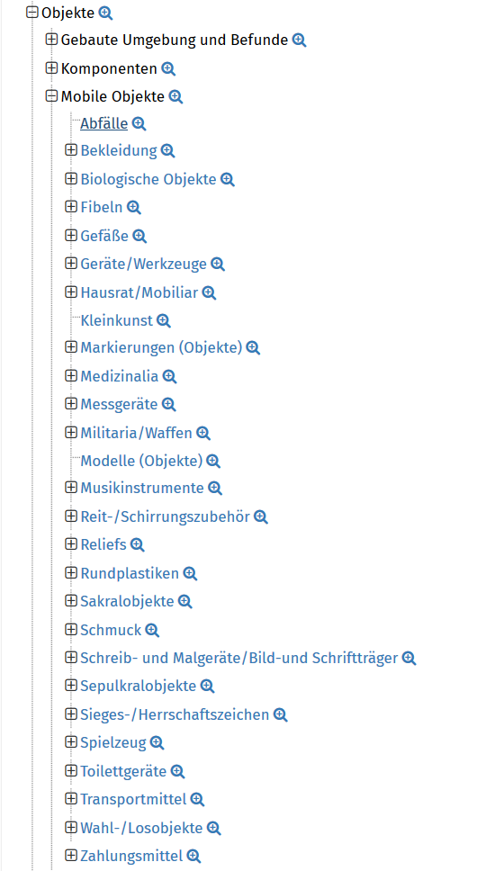
SESSION I LEVEL OF GRANULARITY – MOBILE OBJECTS
DAI-Thesaurus
BBT Curation Committee Annual Meeting Athens 13.11.2019

Slide 6
SESSION I LEVEL OF GRANULARITY – MOBILE OBJECTS
Scope note biological objects:
  This term classifies items of a material nature, which have lived or are natural products of/from living organisms. Examples of biological objects are mummies, mummified objects and other human, animal or plant remains –such as skeletons, fossilized excrement or fossilized seeds.
  NOTE: The object types listed under biological objects are typically things that can be moved; hence, insofar as they result from human endeavor and have aesthetic, cultural, historical, scientific, or other utilitarian value, they can be coordinated with the Mobile objects hierarchy.
BBT Curation Committee Annual Meeting Athens 13.11.2019

Slide 7
SESSION I LEVEL OF GRANULARITY – MOBILE OBJECTS
Current scope note:
  This term classifies material things that result from human endeavor, have aesthetic, cultural, historical, scientific, or other utilitarian value, and are by design or through collecting portable functional entities.
  (Version: 1.2.1 / Submission Date: 11.04.2019 / Submission Id: 2129)
  Why do they have to result from human endeavor?
  Isn‘t portability more important?
BBT Curation Committee Annual Meeting Athens 13.11.2019

