Slide 1
Connecting thesauri to BBT
BBT CC Annual Meeting
November 2019
Christos Georgis

Slide 2
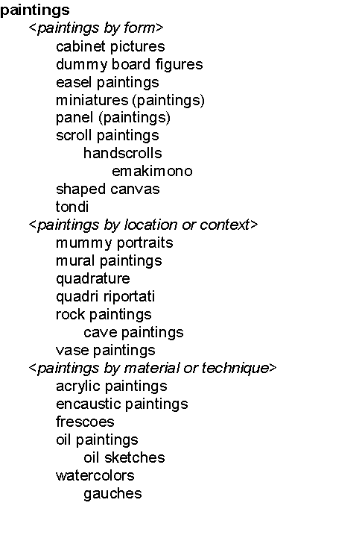

Use of BBT as an overarching thesaurus
...
Backbone thesaurus
Backbone thesaurus
9
6
5
11
7
12
10
8
12
15
6
7
16
9
8
11
Activities
Activities
Conceptual Objects
Conceptual Objects
13
2
10
17
1
3
1
14
2
4
4
13
14
Materials
3
5
Materials
Physical Objects
Physical Objects
Controlled
Vocabulary A
Controlled
Vocabulary B
Local Thesaurus B
Local
Thesaurus A
Local
Maintainer
Local
Maintainer
Notes:
BackBone Thesaurus is an overarching thesaurus for the humanities, which all the vocabularies and terminologies in use in the domain can be aligned, without having local maintainers being forced to abandon their terminology.

Slide 3
Local thesaurus maintenance & accessibility
Local thesaurus is maintained independently by its owners
  new versions (additions/corrections/updates) using thes. editing tools
Local thesaurus (as a whole or partially) is publically accessible
  via local web thesaurus-viewer pages (specific viewer or editing tool)
  see some examples (the concepts IDs are resolvable URIs):
    DAI: “Disziplinen und Fachrichtungen“ http://thesauri.dainst.org/_6e11e02c
    CNRS/FRANTIQ: “vallée” https://ark.frantiq.fr/ark:/26678/pcrtySs2lWdI4z
    AA: “Linguistics” https://humanitiesthesaurus.academyofathens.gr/dyas-resource/Concept/541
  exported/downloaded in RDF/SKOS format
    sometimes online accessible via a SPARQL endpoint service

Slide 4
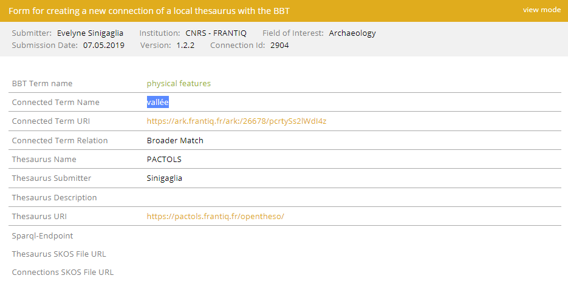
Local thesaurus connection with BBT
local thesauri maintainers connect their vocabularies with the BBT
  using BBTalk Connections tab to declare relations between
  BBT terms and local thesauri terms
Relation options:
Exact Match
Broader Match

Slide 5

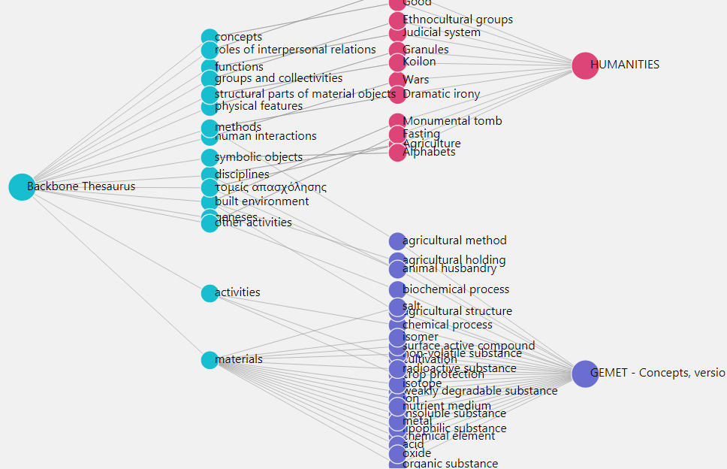
Updating DARIAH-EU federated thesaurus
DARIAH-EU federated thesaurus
  is hosted by ACDH-OEAW Vocabs service/repository
  (https://vocabs.dariah.eu/backbone_thesaurus/en/)
BBT is regularly uploaded to DARIAH-EU federated thesaurus along with all its current connections to local thesauri
  when BBT is updated, or BBT connections to local thesauri change
local thesauri (copies) should also be uploaded to
DARIAH-EU federated thesaurus
  enable faster retrieval
  facilitate better visualization of
  multiple concept schemes and
  relationships among their concepts
  provide uniform view of federated
  thesaurus concepts

Slide 6
Automatic update mechanism
DARIAH-EU federated thesaurus (Vocabs services)
  automatically updates its contents by retrieving info from BBTalk, as BBTalk automatically generates new versions of BBT RDF/SKOS files,
  Vocabs services will fetch them and update Vocabs repository
  Structured in separate files:
    http://backbonethesaurus.eu/BBTalk/bbtFiles/BBT_official.rdf
      main BBT file containing all BBT concepts
      updated e.g. on releasing a new BBT version
    http://backbonethesaurus.eu/BBTalk/bbtFiles/BBT_connected.rdf
      all connections to local thesauri
      updated e.g. on releasing a new BBT version and on creating a new connection, or periodically, or also on admin-request
    http://backbonethesaurus.eu/BBTalk/bbtFiles/BBT_connected_thesauri.xml
      all connected local thesauri and RDF/SKOS related update info

Slide 7
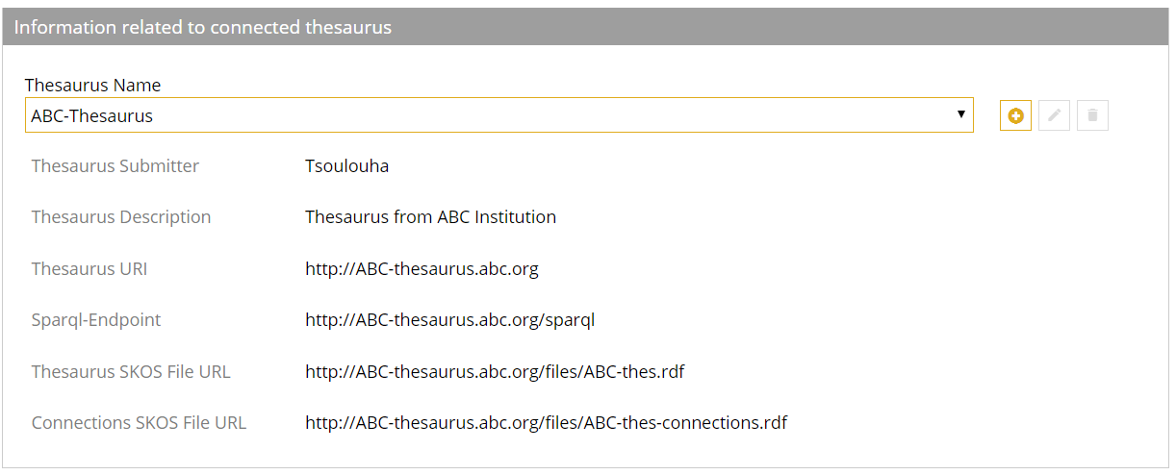
Local thesaurus RDF-SKOS related info
local thesauri information form includes
  URL to SPARQL endpoint (service for dynamic SPARQL queries, if any)
  URL of RDF/SKOS file containing thesaurus concepts
  URL of RDF/SKOS file containing connections of thesaurus concepts
  to BBT concepts

Slide 8
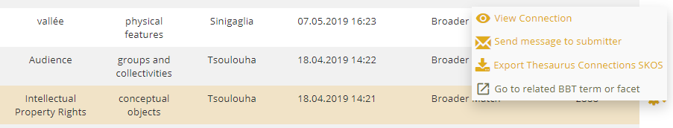
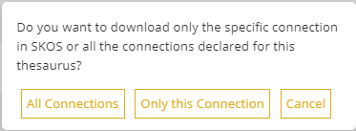
Local thesaurus connections RDF-SKOS file
How to manually create the connections RDF/SKOS file
  choose the action “Export Thesaurus Connections SKOS”
  then choose “All Connections”
  upload the file in the web and make it publicly available through its URL
  finally add its URL in the thesaurus form appropriate field:
  “Connections SKOS File URL”

Slide 9
Local thesaurus connection to BBT - workflow recap
Maintain/update local thesaurus
Make it (or parts of it) public, by generating the RDF/SKOS file of its concepts
Update (if needed) concept connections/links to BBT concepts (in BBTalk)
  create/update/remove connections
  create connections RDF/SKOS file
Upload the two files in the web and make them publicly available through their URLs
Update (if needed) the appropriate fields in BBTalk local thesauri information form
    “Thesaurus SKOS File URL”
    “Connections SKOS File URL”
send an e-mail to ACDH-OEAW Vocabs service administrators (just to be safe)
  Zaytseva Ksenia <Ksenia.Zaytseva@oeaw.ac.at>
  Durco Matej <Matej.Durco@oeaw.ac.at>

Slide 10
Thank you!
(some technical issues follow)
Acknowledgement
BBTalk was designed and developed by:
Chrysoula Bekiari, Lida Charami, Evangelia Daskalaki,
Maria Daskalaki, Korina Doerr, Martin Doerr,
Christos Georgis and Konstantina Konsolaki

Slide 11
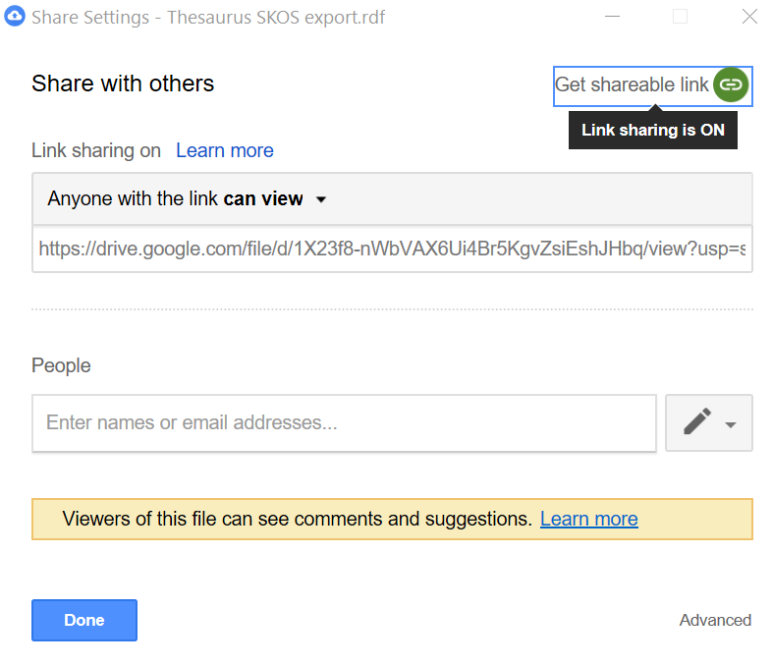
How to upload the RDF/SKOS files on the web
How to upload the thesaurus concept and connections RDF/SKOS files on the web ?
  add the files in your google-drive
  for each file set its share settings: select to be shared for viewing by “Get shareable link” (“can view” option) and copy the provided URL

Slide 12
Back reference issues
Local thesauri maintainers are encouraged to create back references to BBT in their local thesaurus
  using their own thesaurus editing tool
    include Broader Match or Exact Match links/connections from their local thesaurus concepts to BBT concepts on their web thesaurus-viewer pages
  in the case where they do not have a web thesaurus-viewer to disseminate their thesaurus online (or may use their –not so public friendly- thesaurus editing tool as a web thesaurus-viewer)
  ➔
    one possible solution is to use ACDH Vocabs Service as a web thesaurus-viewer for their thesaurus
    yet another solution is to setup an open-software like SKOSMOS (basis of ACDH Vocabs platform) that is easily configurable

Slide 13
Issues with SKOS data quality (contact Ksenia or Matej for details)
General consistency issues (SKOS proper):
  Concept URLs (should be resolvable, “cool URIs”, no IP-addresses)
  Inconsistent Language tags
  More than one prefLabel in one language
  Duplicated relations between concepts
  (both skos:narrower and skos:narrowerMatch)
  Introduce automated validity checks before ingesting
  (ie. http://demo.seco.tkk.fi/skosify/skosify)
Common features required for proper visualization:
  Concept Scheme: URI, rdf:type, skos:ConceptScheme and label
  skos:hasTopConcept and skos:topConceptOf
  Concept: one skos:prefLabel in a given language
  All concepts have skos:inScheme property pointing to main Concept Scheme URI

Slide 14
Thank you

