Slide 1
The BackBone Thesaurus and thesaurus alignment.
Linked Conservation Data Consortium
Terminology Workshop
6-7 June 2019
Stanford University
E. Tsoulouha

Slide 2
Outline
The BackBone Thesaurus:
goals, principles and motivation
The structure of the BackBone Thesaurus:
motivation for its facets & hierarchies
BBTalk: a tool to manage and display the content of the BackBone Thesaurus
Thesaurus Alignment through VisTA, a tool for visual terminology alignment.

Slide 3
The BackBone Thesaurus (BBT)
The BackBone Thesaurus is the research outcome of work undertaken by the DARIAH Thesaurus Maintenance WG in an effort to design and establish a coherent overarching thesaurus for the humanities, under which specialist thesauri and structured vocabularies used across scholarly communities can be aligned and form a thesaurus federation.
It is constructed and maintained collectively by a distributed group of DARIAH affiliated organizations (AA, DAI, FORTH, FRANTIQ), and its content is available in 4 languages (English, French, German, Greek).

Slide 4
Building the BBT; goals
BBT aims at enabling cross-disciplinary resource discovery while ensuring compatibility with thesauri that cover highly specific scientific domains and areas of knowledge in development.
It favors a loose integration of multiple thesauri, by means of mapping them to a small set of high level terms (facets & hierarchies).
  For resource discovery recall is more important than precision
  Terms for discovery can be much coarser than for documentation
  The more generic the concept, the higher the recall
Aligned vocabularies retain their autonomy rather than being subordinated under an all-encompassing thesaurus. They are accessed through the global thesaurus.

Slide 5
Building the BBT; principles
    BBT facets and hierarchies were obtained through a bottom-up analysis of classificatory systems used by humanities researchers.
    Relations btw BBT terms: hierarchical isA
BBT assumes an open-world position: facets and hierarchies within them do not exhaust the domain they classify.
  Complements of terms or negative definitions are not permitted.
BBT is deliberately open to revision: extending the domain of its application, will probably call for the definition of new hierarchies in the BBT, in an orderly fashion (BBTalk)

Slide 6
Motivation for the BBT
BBT concepts heavily draw on CIDOC-CRM classes.
However, efforts have been made to reconcile them with the AAT facets & high-level hierarchies, to some extent.
Seemingly a top-down approach, BUT really a bottom-up process:
  the definition of the CRM is an abstraction over museum documentation standards and practices.
  to be of use to the humanities researchers, BBT structure conform to their terminological systems (to some extent).

Slide 7
The Structure of BBT
Activities (facet)
- activities (top term)
- - disciplines
- - functions
- - human interactions
- - intentional desctructions
Conceptual Objects (facet)
- conceptual objects (top term)
- - symbolic objects
- - propositional objects
- - methods
- - concepts
Geopolitical Units (facet)
- geopolitical units (top term)
Groups and Collectivities(facet)
- groups and collectivities(top term)
Material Things (facet)
- material things (top term)
- - built environment
- - mobile objects
- - physical features
- - structural parts of material objects
Materials (facet)
- materials (top term)
Natural Processes (facet)
- natural processes (top term)
- - geneses
- - natural destructions
Roles (facet)
- roles (top term)
- - offices
- - roles of interpersonal relations
Types of Epochs (facet)
- types of epochs (top term)

Slide 8
Materials [CRM E57 Material, AAT Materials]
Activities (facet)
- activities (top term)
- - disciplines
- - functions
- - human interactions
- - intentional desctructions
Conceptual Objects (facet)
- conceptual objects (top term)
- - symbolic objects
- - propositional objects
- - methods
- - concepts
Geopolitical Units (facet)
- geopolitical units (top term)
Groups and Collectivities(facet)
- groups and collectivities(top term)
Material Things (facet)
- material things (top term)
- - built environment
- - mobile objects
- - physical features
- - structural parts of material objects
Materials (facet)
- materials (top term)
Natural Processes (facet)
- natural processes (top term)
- - geneses
- - natural destructions
Roles (facet)
- roles (top term)
- - offices
- - roles of interpersonal relations
Types of Epochs (facet)
- types of epochs (top term)

Slide 9
CRM Perdurants and related AAT concepts in BBT
Material Things (facet)
- material things (top term)
- - built environment
- - mobile objects
- - physical features
- - structural parts of material objects
Materials (facet)
- materials (top term)
Natural Processes (facet)
- natural processes (top term)
- - geneses
- - natural destructions
Roles (facet)
- roles (top term)
- - offices
- - roles of interpersonal relations
Types of Epochs (facet)
- types of epochs (top term)
Activities (facet)
- activities (top term)
- - disciplines
- - functions
- - human interactions
- - intentional destructions
Conceptual Objects (facet)
- conceptual objects (top term)
- - symbolic objects
- - propositional objects
- - methods
- - concepts
Geopolitical Units (facet)
- geopolitical units (top term)
Groups and Collectivities(facet)
- groups and collectivities(top term)

Slide 10
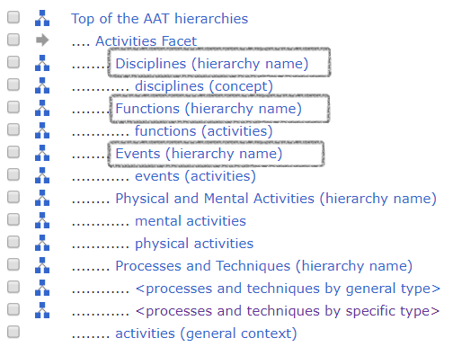
BBT Activities facet: a specification of the type of CRM E7 Activity
Its most salient feature is intentionality.
It does not map to the AAT facet –the latter does not presuppose intentionality.
However, there has been an effort to partially maintain the structure of the AAT respective facet in the BBT hierarchies:
  disciplines
  functions
  human interactions
intentional destructions on the other hand specify a subset of E63 End of Existence events, provided they were carried out by volitional agents.

Slide 11
Natural Processes does not map to any CRM class in particular; rather, it is an abstraction over:
  geneses:
    the subset of E63 Beginning of existence events, characterized by the absence of a volitional agent.
  natural disasters:
    the subset of E64 End of existence events, characterized by the absence of a volitional agent.
It does not map to the AAT either, where natural events isA events isA activities.

Slide 12
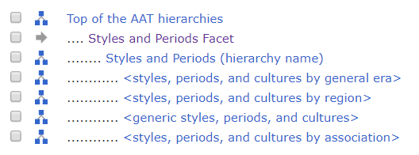
BBT Types of Epochs facet: a specification of the type of CRM E4 Period.
It differs from the AAT Styles and Periods, insofar as the latter also comprises instances of specific periods in Art and Architecture, whereas the BBT only permits isA relations between types.

Slide 13
CRM Perdurants and related AAT concepts in BBT
Keeping the BBT as small as possible, means that some of the distinctions have to be made at a higher level.
The BBT does not theorize on the properties of temporal entities, so there is no need to make the relation among the three facets explicit.

Slide 14
CRM Endurants & and related AAT concepts in BBT
Activities (facet)
- activities (top term)
- - disciplines
- - functions
- - human interactions
- - intentional desctructions
Conceptual Objects (facet)
- conceptual objects (top term)
- - symbolic objects
- - propositional objects
- - methods
- - concepts
Geopolitical Units (facet)
- geopolitical units (top term)
Groups and Collectivities(facet)
- groups and collectivities(top term)
Material Things (facet)
- material things (top term)
- - built environment
- - mobile objects
- - physical features
- - structural parts of material objects
Materials (facet)
- materials (top term)
Natural Processes (facet)
- natural processes (top term)
- - geneses
- - natural destructions
Roles (facet)
- roles (top term)
- - offices
- - roles of interpersonal relations
Types of Epochs (facet)
- types of epochs (top term)

Slide 15
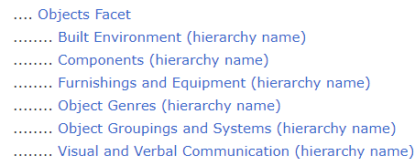
Material Things facet
Material Things (facet): E18 Physical Thing
- material things (top term)
- - built environment E25 Man Made Thing
- - mobile objects E22 Man Made Object
- - physical features E26 Physical Features
- - structural parts of material objects the physical things selected by P46 is composed of
An area of almost complete overlap with the AAT.

Slide 16
Conceptual Objects facet
Conceptual Objects (facet) E28 Conceptual Object
- conceptual objects (top term)
- - symbolic objects E90 Symbolic Object
- - propositional objects E89 Propositional Object
- - methods E29 Design or Procedure
- - concepts ?
Incompatibility with the AAT.

Slide 17
CRM Actors and related AAT concepts in BBT
People that individually or in groups have the potential to perform actions intentionally, and be held responsible for them.
Groups and collectivities handles people acting collectively
Actors perform Activities, in a given capacity and participate in other Events of specific type.
  E7 Activity –P14 carried out by –E39 Actor
  14.1 in the role of –E55 Type
  Roles (facet)
  E5 Event –P11 had participant –E39 Actor
  roles of interpersonal relations
The scope note definition of E74 Group foresees the extreme case of groups with exactly one member (f.i.: people holding offices)
  offices

Slide 18
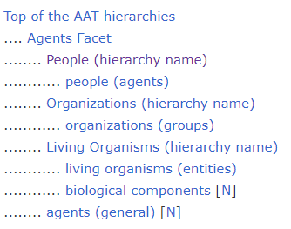
CRM Actors and related AAT concepts in BBT
Geopolitical Units represents a borderline case of Actor, one that combines organizational features (an administration and a jurisdiction) and spans over a geographical and temporal extent.
Overall, there is significant overlap with the AAT Agents facet.
AAT People map to BBT Roles and Groups & Collectivities (to the extent they do not exhibit organizational features),
AAT Organizations (not administrative or political ones though) map to BBT Groups and Collectivities as well.
The remainder of AAT Organizations map to BBT Geopolitical Units

Slide 19
BBTalk: A tool for federated thesaurus management
BBT aims to bring together a federation of vocabularies spanning the Arts and Humanities and to render them interoperable.
BBTalk is an online service for managing thesauri integration with the BBT and updating its content, when necessary.
BBTalk offers a thesaurus alignment functionality allowing end users:
  create links among specialist thesauri and the BBT .
  provide evidence confirming/disconfirming the high-level terms of the thesaurus itself.
https://www.backbonethesaurus.eu/BBTalk/

Slide 20
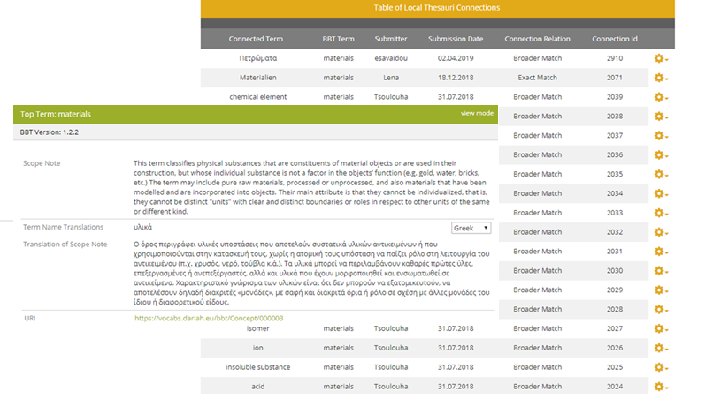
BBTalk: A tool for federated thesaurus management
End users can browse through the connections to BBT via BBTalk

Slide 21
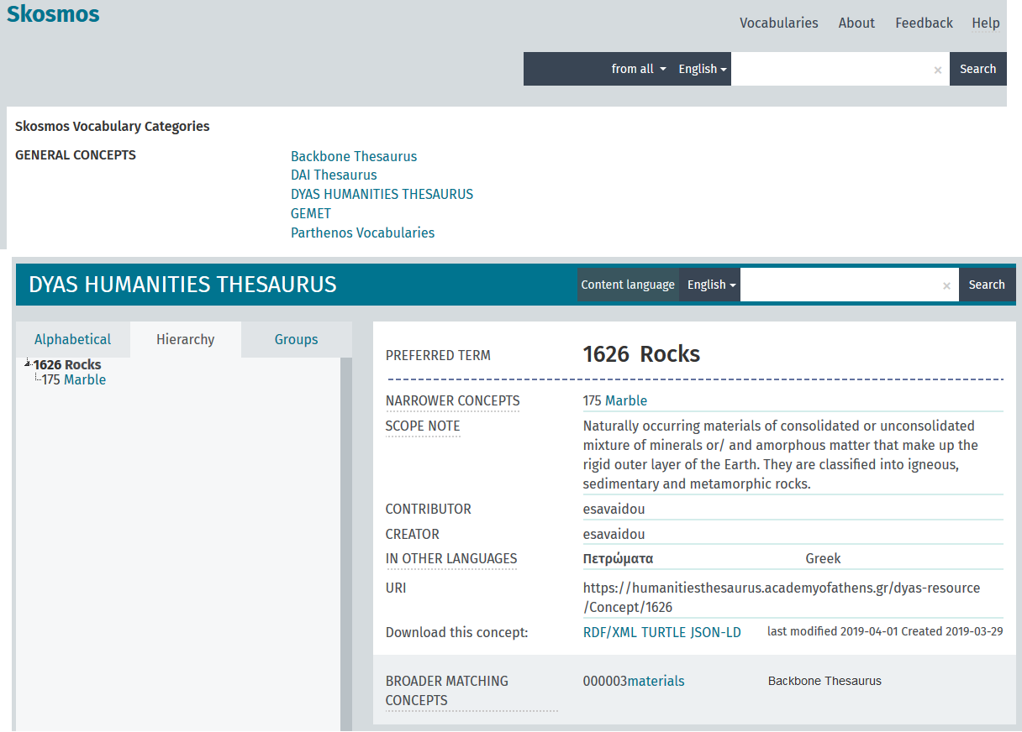
They can also navigate through the federated thesauri overarched by BBT and browse through their hierarchies, through the Federated Thesaurus Viewer.
https://isl.ics.forth.gr/apollonis-federated-thesaurus/en/

Slide 22
BBTalk: A tool for federated thesaurus management
Clashes between BBT concepts and thesauri aligned to it can be resolved by updating the content and/or structure of the BBT.
Updating the BBT involves the introduction of new high-level terms plus the deletion/merging or splitting of existing ones.
  BBTalk keeps track of such actions and allows for version control.
Changes are implemented after careful consideration and discussion among the BBT managing team, until consensus is reached.
  BBTalk supports discussions among end-users and its managing team.
BBTalk supports multilingual content.

Slide 23
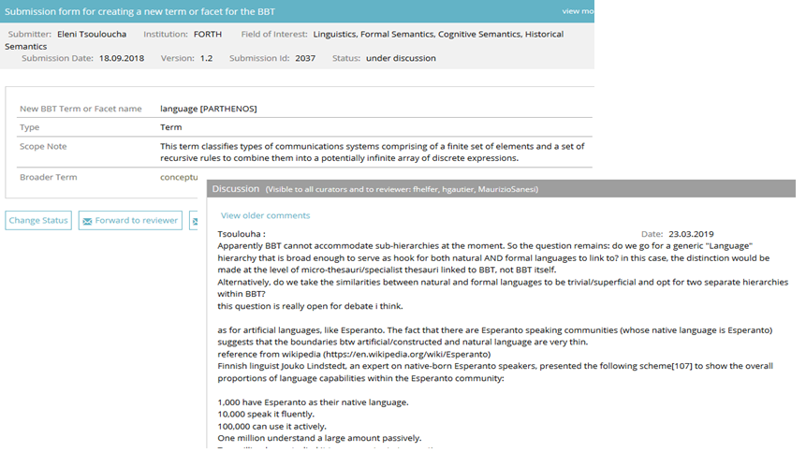
BBTalk: A tool for federated thesaurus management

Slide 24
Thesaurus Alignment
The purpose of terminologies alignment is to integrate knowledge, to support the communication among individuals, teams and communities coming from different scientific, cultural, technical and other domains.
  to integrate different terminologies under one target terminology used as a core terminology in a knowledge aggregator. The core terminology gets extended with new specialized terms.
  to empower searching capabilities in a semantic network, as the users of different terminologies are enabled to make queries using the common target vocabulary together with their own familiar vocabularies, to find more resources in their results.

Slide 25
ViSTA: a Visual Terminology Alignment tool
ViSTA offers a simple and friendly web-based user interface for an exact, target-driven, human-interactive terminology alignment.
The alignment follows three principles:
  Terminologies and the alignment result are acyclic graphs preserving the taxonomy subsumption (is-a)
  The broader and narrow relations are symmetrically inversed
  Target-driven reconciliation of the source terminology: the source conforms to the target but not the reverse

Slide 26
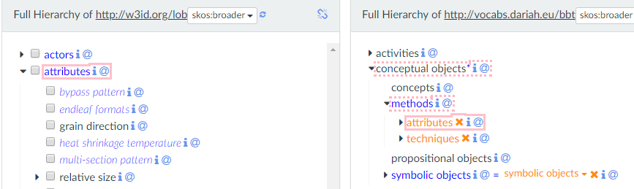
VisTA key features
The adaptation of the structure of the source terminology is supported by the tool: removal of the incompliant subterms that break the subsumption of the target

Slide 27
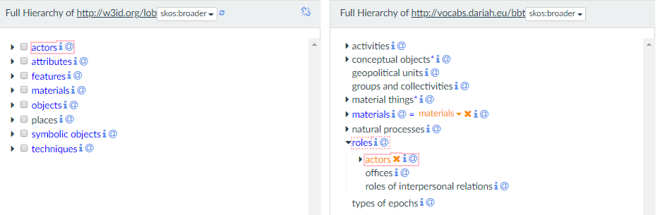
Multiple-inheritance of terms is allowed (unless it breaks subsumption)
The extension of the target terminology is based on broader match and the exact match relations

Slide 28
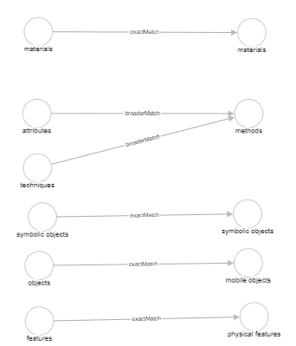
The result of the Alignment
For each pair of aligned terminologies, ViSTA produces an alignment graph in RDF/SKOS.
The graph contains:
  the correspondences between terms
  the children hierarchy of the source terms
Searching space:
  Alignment graph + Target terminology graph

Slide 29
To align or not to align?
And more importantly what target to align to?
It really depends on one’s purpose

Slide 30
BBT alignment:
A fairly easy and quick process, given its small set of facets & hierarchies
Terminologies are linked at a high-level to the BBT and preserve their autonomy
One can publish their thesaurus and become part of the thesaurus federation
Assuming there is no appropriate node with which to align, one can always propose a new branch within BBT (to be examined by the managing team)
At the same time, (s)he can fully align a terminology or a subpart thereof to another terminology discovered through Skosmos (in the future)

Slide 31
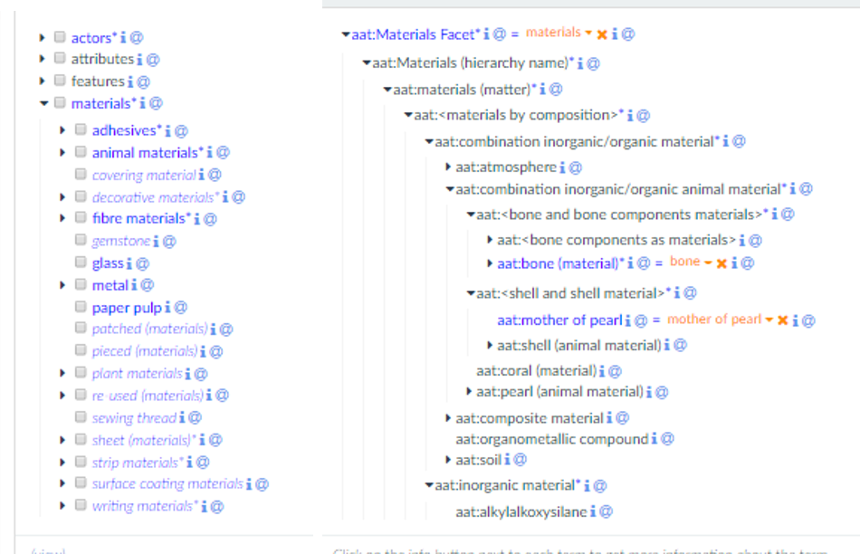
Alignment with a fully-fledged thesaurus:
It’s a massive task, given the depth of the relations.
It also addresses a different problem:
Wanting to reorganize a facet or other part of one’s thesaurus and looking for a good terminology to align to!

Slide 32
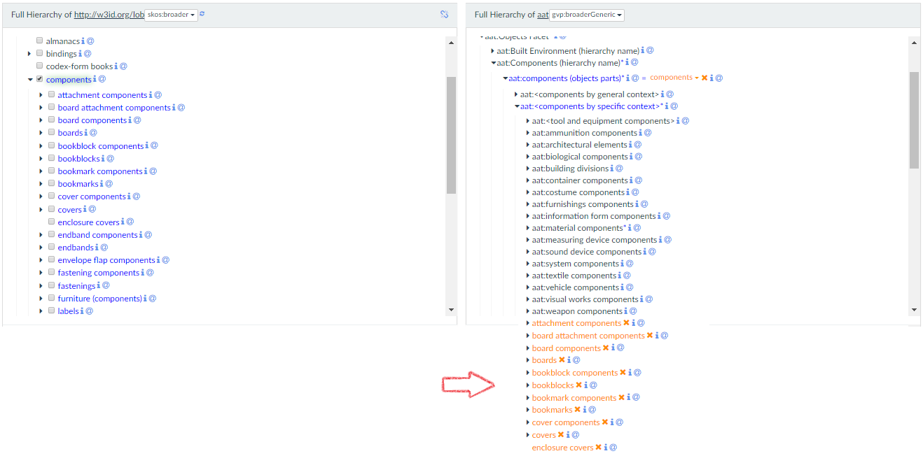
One can’t be sloppy!!
Rather, (s)he must establish exact
correspondences, which requires
an in-depth knowledge of both
source and target vocabularies

