Slide 1
BBTalk - Submission and Connection Management Tool
Notes:
Today we will present BBTalk: a tool for managing connections and submissions for BackBone Thesaurus.

Slide 2
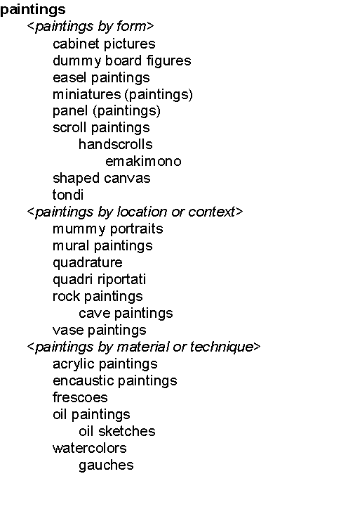

Use of BBT as an overarching thesaurus
we need a common set of high-level concepts:
to enable the classification in a consistent and objective way
to ensure compatibility among different thesauri
...
Backbone thesaurus
Backbone thesaurus
9
6
5
11
7
12
10
8
12
15
6
7
16
9
8
11
Activities
Activities
Conceptual Objects
Conceptual Objects
13
2
10
17
1
3
1
14
2
4
4
13
14
Materials
3
5
Materials
Physical Objects
Physical Objects
Controlled
Vocabulary A
Controlled
Vocabulary B
Local Thesaurus B
Local
Thesaurus A
Local
Maintainer
Local
Maintainer
Notes:
Different local thesaurus maintainers are working independently, following their own disciplines, based on their own terminology.
In order for multiple existing thesauri to become interoperable (click),
we need a common set of high-level concepts:
to enable the classification in a consistent and objective way
to ensure compatibility among different thesauri
Thus we came up with BackBone Thesaurus (aka BBT), an overarching thesaurus for the humanities, under which all the vocabularies and terminologies in use in the domain can be aligned.
This grey triaglular area (click) represents BBT, under which we expect local maintainers to align their thesauri, without being forced to abandon their terminology.

Slide 3
BBTalk - Submission and Connection Management Tool
enables local thesauri maintainers to align their vocabularies with the BBT
  allows them to link their terms to BBT, by creating connections between LOD identified BBT terms and local thesauri terms
  notifies all interested parties on BBT changes
supports discussions between the curators of BBT and its potentials users
  allows potentials users to submit requests for possible changes (submissions regarding the facets and the hierarchies of BBT)
  supports discussions regarding the submissions
  keeps track of the different versions of BBT and the history of the submissions (related past discussions)
  notifies all interested parties, about the progress of a submission
Notes:
We have developed BBTalk a management tool for submissions and connections.
...

Slide 4
BBTalk - Submission and Connection Management Tool (2)
enables curators to implement changes to BBT hierarchies and facets
  allows curators to implement changes on BBT concepts, based on the submissions and the following discussions
  allows the preview of the thesaurus release which is under implementation
  allows the release of new versions
  allows the comparison of different versions of BBT
  notifies all the interested parties, about the release of the new version of BBT
Developed and maintained by FORTH-ICS (www.ics.forth.gr).
Current version: www.backbonethesaurus.eu/BBTalk

Slide 5
BBTalk – User roles
Contributors: The contributors are those persons who wish to suggest changes on BBT concepts (requesting additions, deletions or modifications ).
Contributors can be local thesauri maintainers who wish to link their local thesauri terms to concepts in BBT.
Furthermore, contributor could be any person who is interested in browsing the BBT terms, their history of submissions and their connections with other thesauri terms.
Curators: The curators are responsible for the maintenance of BBT. Their role is to make changes to the thesaurus by consulting the submissions concerning the current and the previous versions of the thesaurus. They might also ask the consultancy of the thesaurus reviewers in order to take a decision about a specific request.
Reviewers: The reviewers review submissions forwarded by the curators that are pertinent to their expertise (domain of knowledge), and respond back to the curators with proposed changes to BBT.
Administrators: The system administrators are responsible for the maintenance of the system information and the system software: manage the new users, take and restore backups, etc.
Notes:
BBT support different user roles...

Slide 6
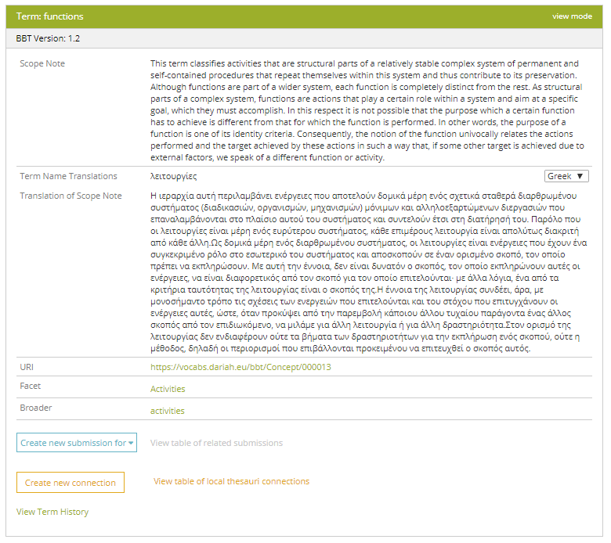
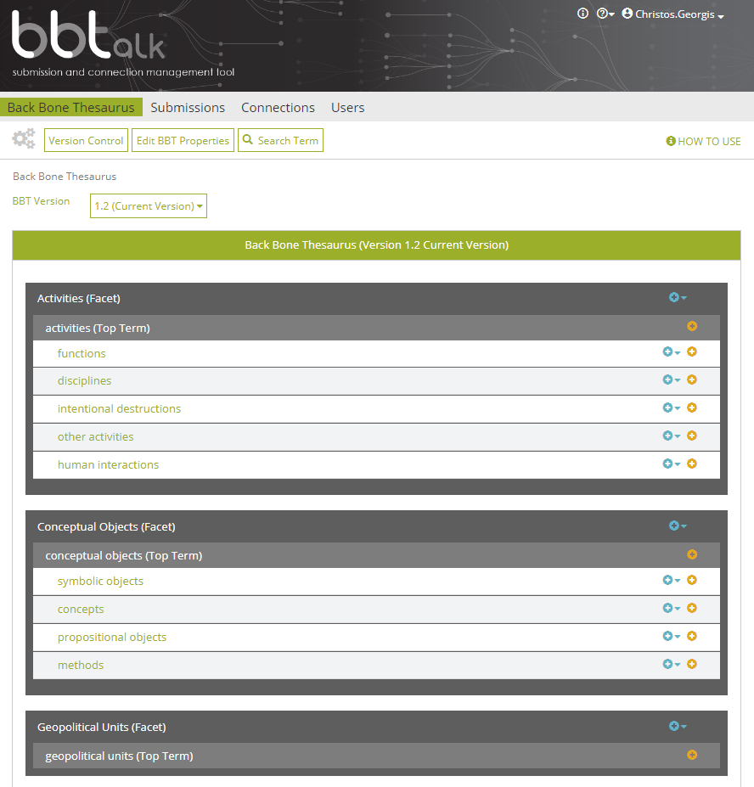
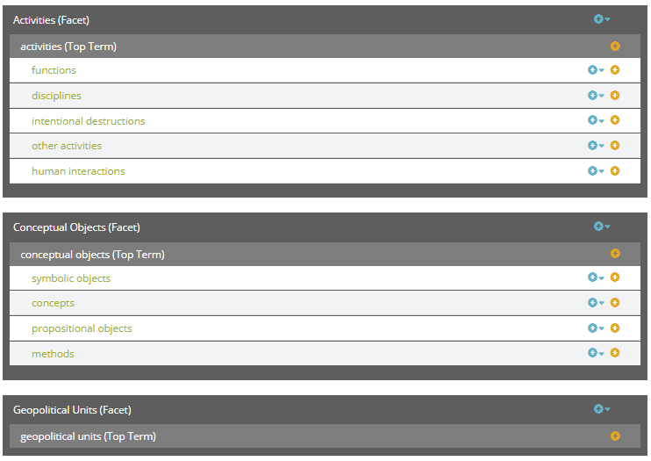
Browse the BBT
Notes:
BBTalk let the user browse through BBT facets and hierarchies,
by providing (click) a hierarchical view of the thesaurus
The user can make submissions and connections (click) by using the actions provided on the right
or inspect concept details (click) by selecting the concept name
This opens up a form (click) containing all the concept details, such as concept name, scope note, translation, broader term etc.
The form provides links that enable the user to navigate through BBT and to access all related information such as (click) the lists of submissions and connections related to the BBT concept, or (click) the history of the concept on the bottom of the form

Slide 7
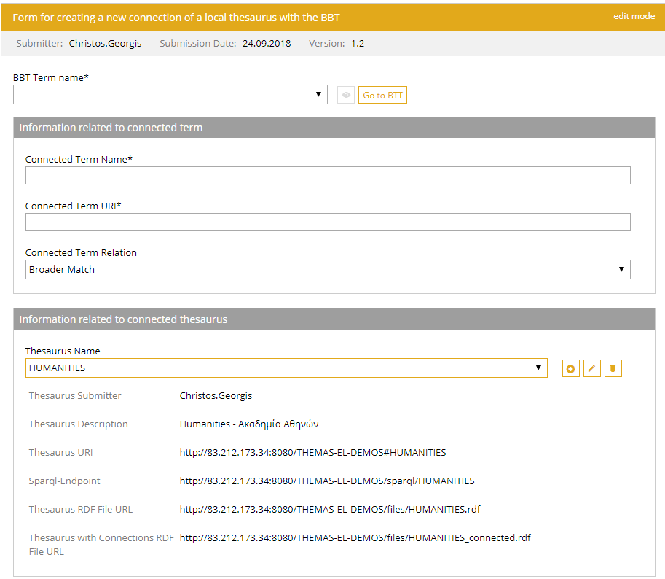
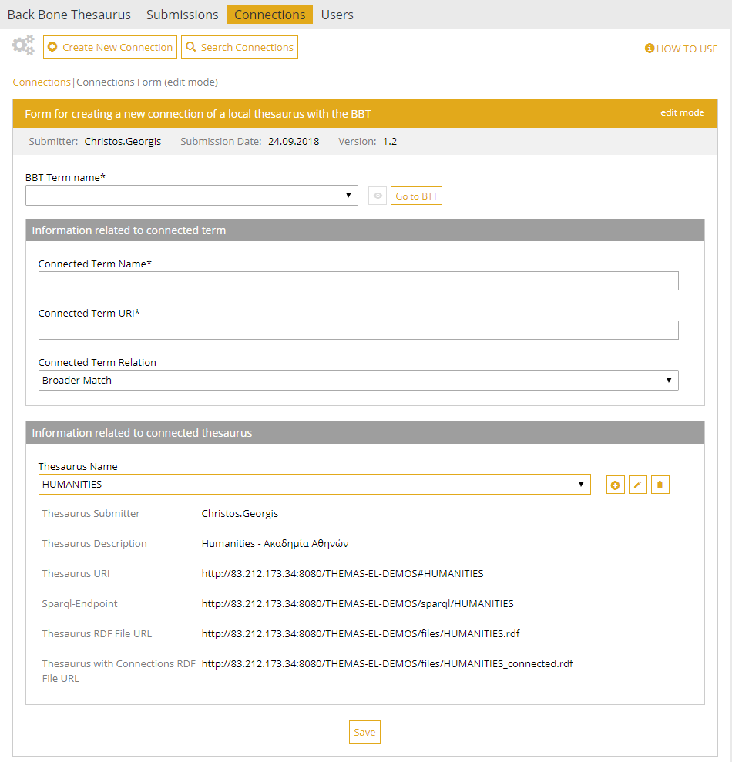
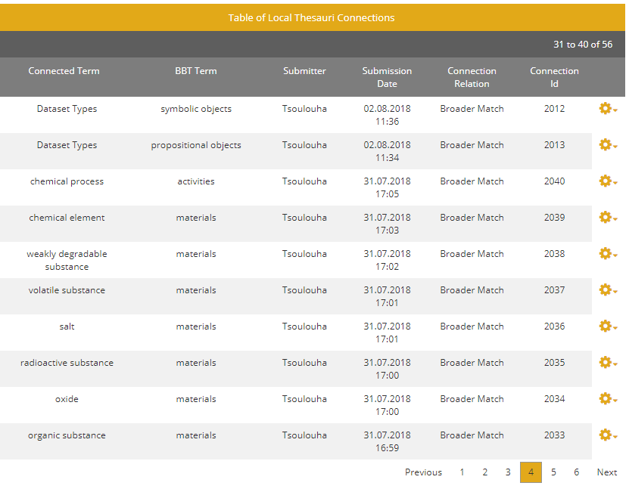
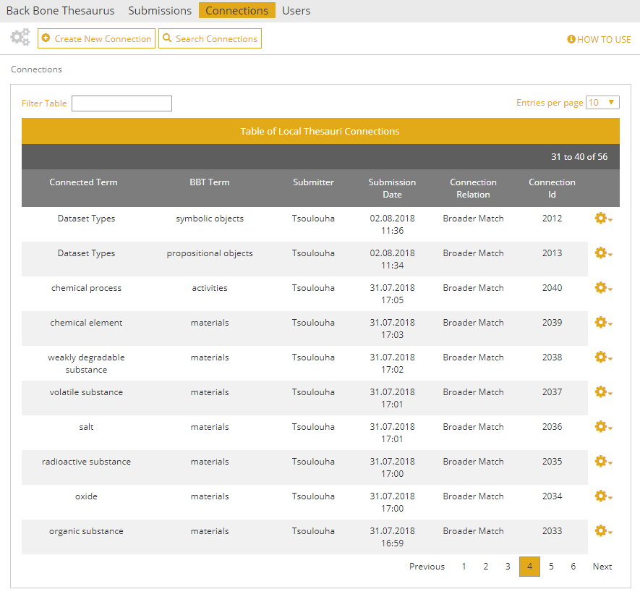
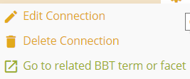
Create and Manage Connections
Notes:
For connections BBTalk provides two main interfaces:
the connection form and the connections list (all the connections)
The connection form (click) contains information about the connection from a BBT concept to a local thesaurus term local: BBT term name, local thesaurus term name and URI, and relation: ExactMatch, BroaderMatch
On the lower part we see detail on local thesaurus: Name, Short Description, related RDF files
The connections list (click) on the other hand contains all connections. For each connection the user can choose to view the connection details (connection form) by selecting (click) the connection row or perform actions on the connections such as Edit and Delete Connection by selecting (click) the actions available on the right side.

Slide 8
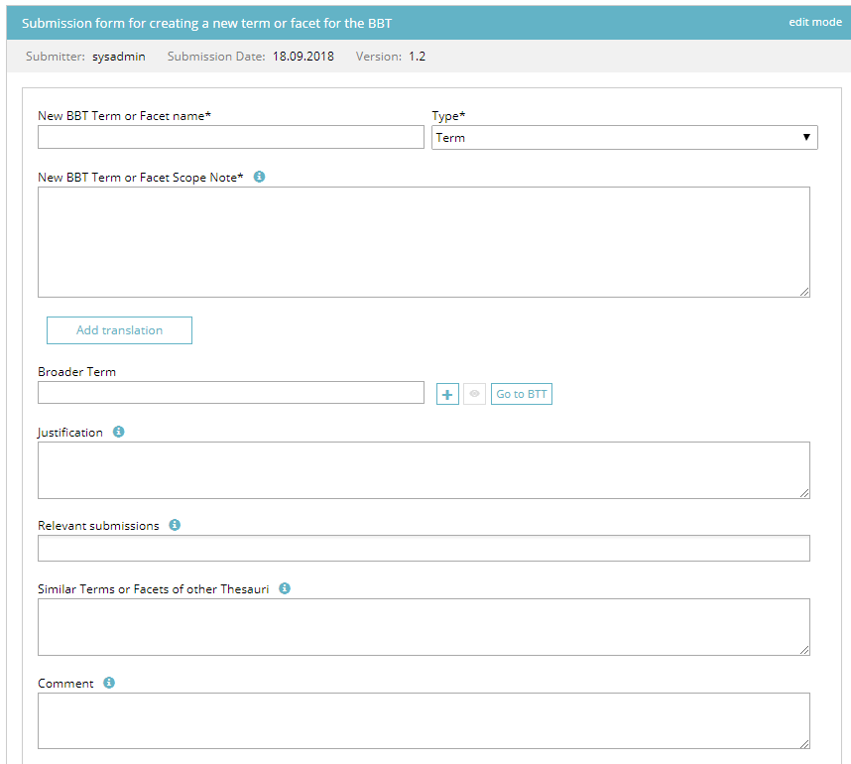
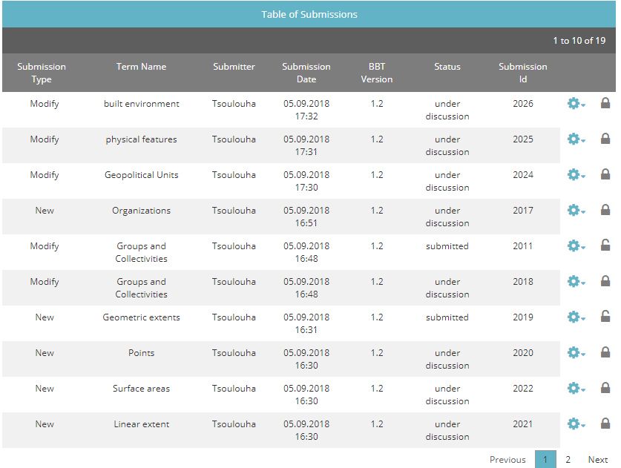
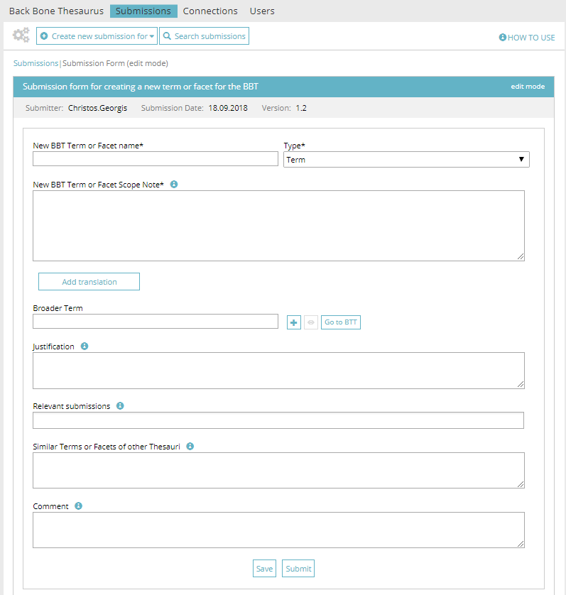
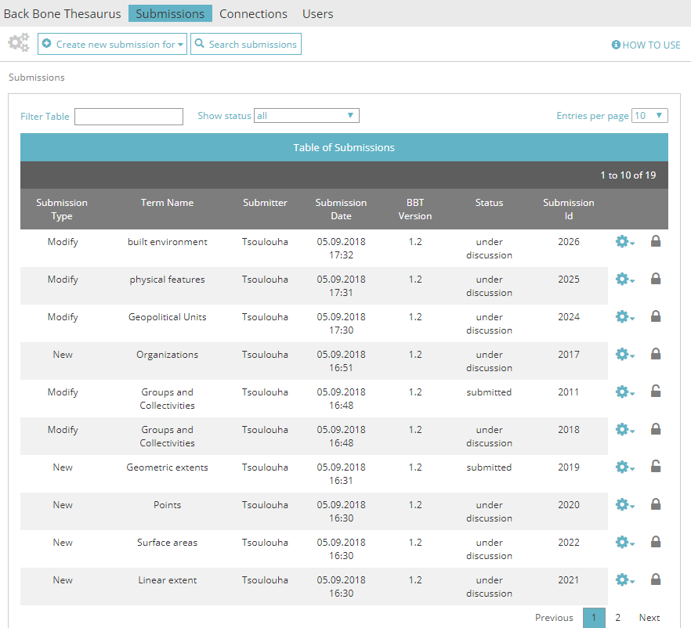
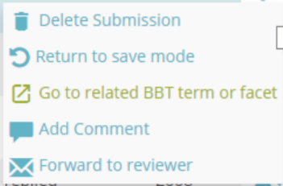
Create and Manage Submissions
Types of submissions:
  Add new term/facet
  Delete term/facet
  Modify term/facet
  Merge terms/facets
  Split term/facet
Notes:
For submissions BBTalk provides again two main interfaces:
the submission form and the submissions list (all the submissions)
The submission form (click) contains information about the submission related to a BBT concept: BBT term name, Type of submission, justification, related submissions, etc.
Submission form fields depend on the type of the submission. The available types (click) are:
Add new term/facet
Delete term/facet
Modify term/facet
Merge terms/facets
Split term/facet
The submission list (click) on the other hand contains all the submissions. For each submission the user can choose to view the submission details (submission form) by selecting the submission row or perform actions on the submission such as Edit Submission, Add comment, Forward to a reviewer, by selecting the actions available on the right side.

Slide 9
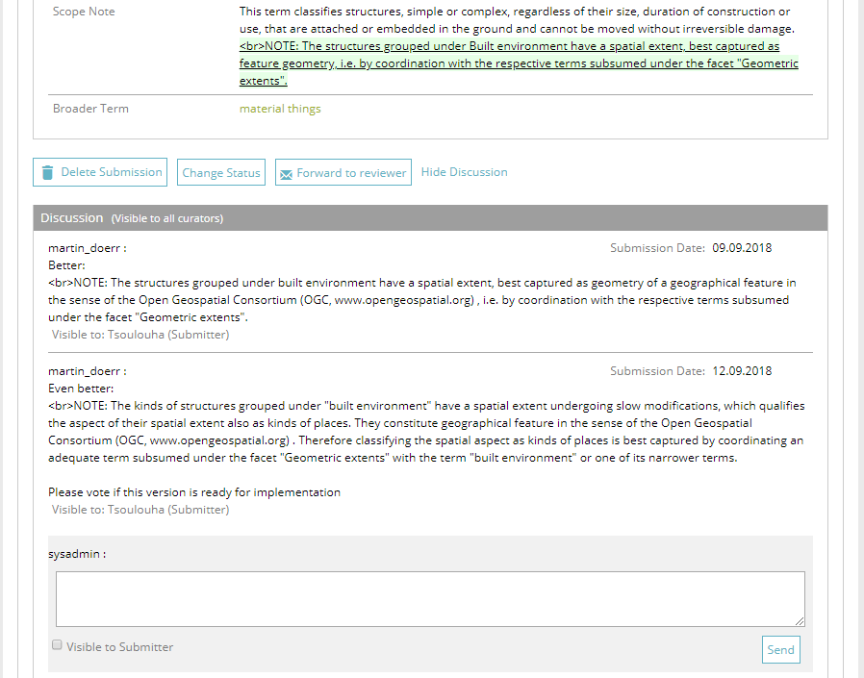
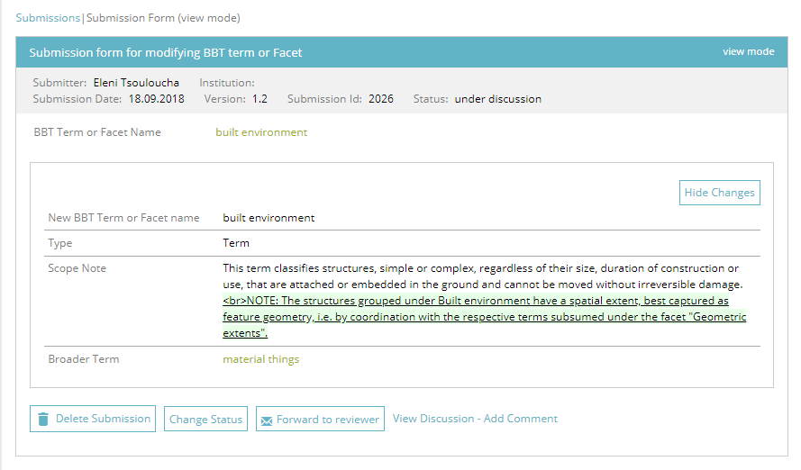
Discussion on Submissions
Notes:
The rightful user can view or participate on a discussion
by selecting (click) View Discussion – Add Comment.
Then the lower part of the form is extended (click) and the user’s comments are made visible, along with details about when and by whom each comment was made.
Discussion is visible only to the members of the curators-committee and to the invited reviewers (if any).
Note that some comments can be made visible to the submitter by selecting (click) “Visible to submitter” option when a comment is added.

Slide 10
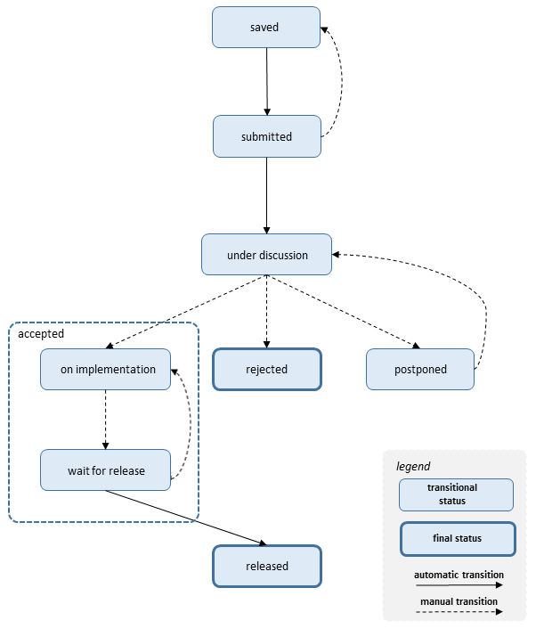
Submission workflow and submission statuses
saved
submitted
under discussion
rejected
postponed
on implementation
wait for release
released
Notes:
Its now time to discuss about the submission workflow and the relevant submission statuses.
A submission when created can be saved multiple times before the user decides to submit it.
The owner of a submitted submission can change the status back to saved, (and continue editing), if the submission-discussion has not started.
Once under discussion the submission may take some time to finish. At the end of the discussion phase, (click) it can be either rejected, postponed or accepted (on implementation).
When a submission is marked on implementation a curator takes the responsibility to get the result from the discussion and complete the Release Term form thus implementing the changes on the specified BBT concept.
Once he completes the implementation of the change, he can set the submission status (click) to wait for release. A submission marked as wait for release may be returned to status on implementation by the curator.
Finally, when the committee decides to release a new BBT version, all submissions marked as wait for release change to released.

Slide 11
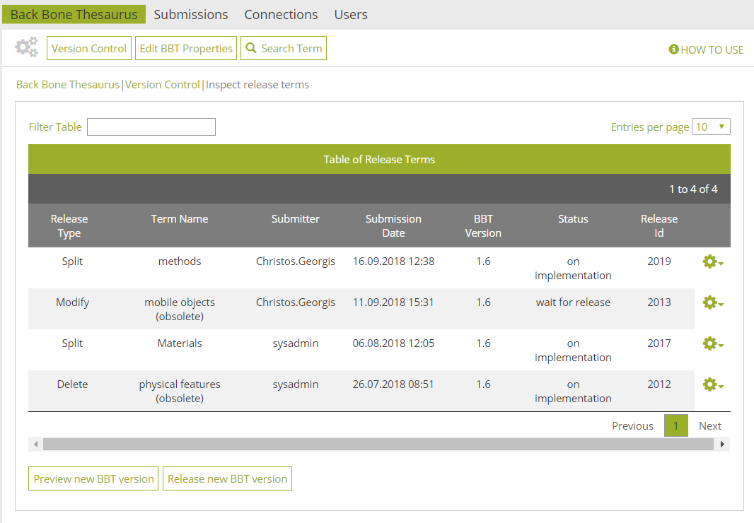
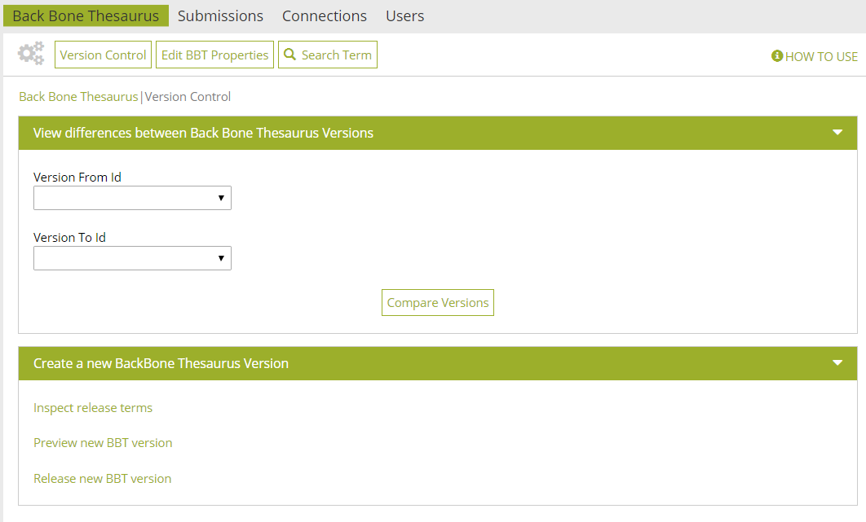
Version Control - Implementing Changes on BBT
Notes:
BBTalk provides an interface for version control. The curators may implement the changes (click) that are marked as accepted by selecting Inspect Release Terms option.
This opens the list of submissions (click) marked as under implementation or wait for release. This is the list of Release Terms.
From this list may open the release term form (click) and see the details of the specific release term, or select an action (click) (such as Edit Release Term) from the available actions on the right.

Slide 12
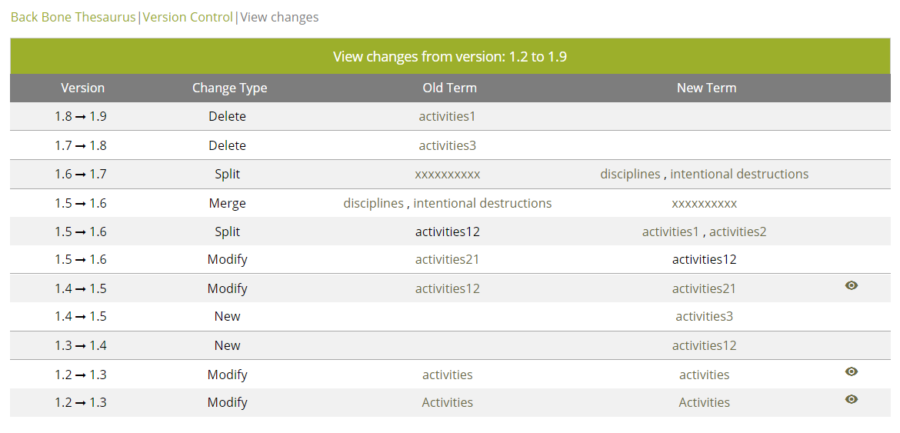
Version Control - Comparing versions BBT
Notes:
Another option that BBTalk provides from version control interface is that enables the user to (click) compare different BBT versions, by selecting the version he wants to compare.
A list of changes appears (click) displaying the version transition, the type of change, and the involved old and new terms. In case of modification the user can see the actual differences made to the BBT concept properties.

Slide 13
Future plans
Our funding proposal to the DARIAH Theme 2018 "Strategic Service Sustainability for DARIAH“ (submitted on Sept. 9th, 2018) focuses on:
the activation the BBT-curators committee (FORTH,AA,DAI): co-deciding on proposed connections and submissions for changes to the BBT, by using the BBTalk.
the promotion of BBT: meet potential BBT users (institutions, or local thesaurus maintainers) and propose the use of the BBT as a core structure.
the creation of set of training video tutorials to be publicly available to help new users familiarize themselves with the tools.
implementation of additional functionality and maintenance of BBTalk
Notes:
In the framework of DARIAH Theme 2018 "Strategic Service Sustainability for DARIAH“ we made a funding proposal related to BBTalk, which was submitted on Sept. 9th, 2018, and focuses on:
…

Slide 14
Acknowledgments
BBTalk was designed and developed by:
Chrysoula Bekiari, Lida Charami, Evangelia Daskalaki, Korina Doerr, Martin Doerr, Christos Georgis and Konstantina Konsolaki

