Slide 1
Interconnecting knowledge and information in Digital Humanities
The case of the Backbone Thesaurus
DARIAH-Annual Event 2018, 22-24 May Paris

Slide 2

Integration of new technologies and the traditional research.
Facilitating collaboration across different scientific fields.
Notes:
Problem statement: The new and rapid need that emerges in the field of digital humanities is to integrate new technologies and the traditional research in the humanities in order to enable collaboration across different scientific fields. This integration, however, is not as easy and straight forward as it sounds since it entails the existence of a “common language” which could facilitate the communication between different disciplines through the usage of modern technological means.

Slide 3

…. we have developed an coherent overarching thesaurus
Notes:
More specifically, in the context of classifying knowledge and information the demand for building a common language enabling communication between different scientific fields has led us to develop a coherent overarching thesaurus which facilitates research across the humanities providing us with a common scheme. The major advantage of the overarching thesaurus is that it transcends the limits of each discrete scientific domain, which frequently prompt the experts to create thematic vocabularies.

Slide 4

Our aims in building the BBT
Notes:
Thus our research aimed at building a Backbone Thesaurus (BBT) that would: a) Enable interoperability between different scientific fields.
b) Allow access, compatibility and comparison across heterogeneous classification systems.
c) Harmonize the numerous discipline and even project specific terminologies into a coherent and effective federation in which consistency could progressively be imposed from the upper layers to the lower ones, without forcing the experts to abandon their own terminology.
d) Deter, as far as possible, the subjective classification of the terms so as to ensure its validity.
e) Avoid the logical errors or idiosyncratic decisions which lead to inconsistencies.
f) Avoid backwards-incompatible restructuring of classification systems.
g) Enable users to access information that may have an impact on their research regardless of their backgrounds and knowledge.
h) Ensure that users can find, learn, understand and use the terms needed for their research inquiries with a reasonable effort and efficiency.
i) Achieve the greatest economy in the process of organizing terms in a common framework.

Slide 5

Epistemological and methodological background of the BBT.
Interdisciplinary character of our goals.
Need for study of the epistemological principles and methodological preconditions.
Notes:
Epistemological and methodological background: The goals that guided our research are basically a restatement of the classic scientific claims for objectivity, interdisciplinarity and transparency that govern science since its birth. Therefore, it seemed important to us to originally turn our attention to the study of the epistemological and methodological principles and preconditions that underlie our endeavor and make the request for a common language feasible.
The epistemological and methodological principles presented in the following but also the practical guidelines that are derived from them, are the outcome of an effort by a team of experts in designing and building effective and efficient classification systems for research infrastructures in the humanities. The method has been verified by the construction of the initial “back bone thesaurus” for DARIAH. Our work focuses on identifying the top-level-concepts (facets and hierarchies) that will become a common basis for thesaurus building, meeting the demands for objectivity and interdisciplinarity.

Slide 6

1. The criteria of building the upper level categories and subsuming terms should be logically and intersubjectivity controlled
Basic epistemological principles
Notes:
Basic epistemological principles in designing the BBT:1. The criteria of building the upper level categories and subsuming terms must be logically and intersubjectivity controlled. In designing and building a vocabulary for indexing knowledge and information that will meet the demand for intersubjectivitiy and inderdisciplinarity, we should avoid the criterion of the affinity of the meaning in both building the upper level categories of indexing and in subsuming the terms. The reason is that such a classification which is based on the affinity of the meaning (the content-oriented classification) is frequently driven by criteria external to the substantial properties of the concepts themselves and depends on empirical factors, such as the person who classifies, his/her background, the existing interpretations of the terms, the influences of the social environment, the context, in which the terms are found etc. This means that a content-oriented classification cannot exclude the possibility that contradictory and/or inconsistent terms may coexist in the same hierarchy.

Slide 7
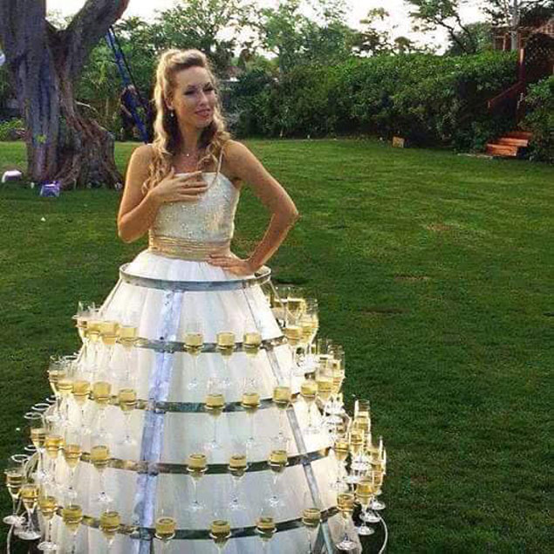
content-oriented classification leads to inconsistencies and frequently to contradictions
Example: which is the common ground between the terms “wedding dress” and “wedding reception”?
Could it be “wedding” as a top-level category?
Notes:
Let us see an example: which is the common ground between the terms “wedding dress” and “wedding reception”?
Could it be “wedding” as a top-level category? If we follow the criterion of the meaning then it is possible to subsume those terms under the more general term “wedding”.
But according to the substantial properties of the terms, independent from the context of reference, “wedding dress” is an object, which has a certain quality which is that of materiality, while reception is an event which is a kind of action, to which the participants participate intentionally. So the terms have totally different properties and cannot belong to the same category!
We could conclude thus that in order to design a sustainable thesauri for the humanities, we should have in mind that the concepts that we intend to adopt or create should be defined on the basis of their substantial properties, which are accepted regardless of the scientific field in which they are applied. But how could we detect the substantial properties of the terms?

Slide 8
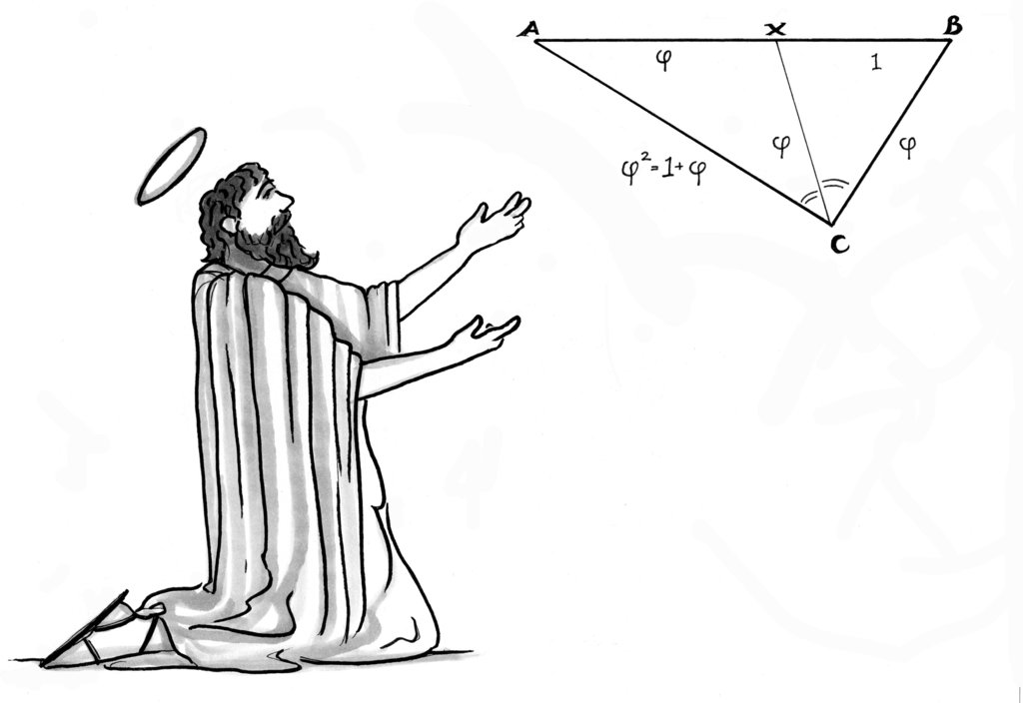
Important clarification: The intersubjective character of the properties does not entail their ontological existence independently of the sphere of perception!
Notes:
At this point it needs to become clear that the fact that we try to distinguish the definitions of a concept based on its substantial properties and its interpretations by the subject, does not mean that we conceive the concepts as if they were separate entities beyond the world of the subjects. After all, the act of defining a concept is placed within the sphere of perception and has only to do with the subject and the way it perceives its reality.
The detection of the substantial properties has rather to do with the intersubjective character of knowledge and information in order to be communicapable and acceptable. Following in this point Habermas’ terminology, we call this form of definitions that is based on the detection of the substantial properties of the terms, quasi a priori, since their meaning is intersubjectively accepted as valid. As Elaine Svenonius states,the definitions based on the intersubjectivity implies an “ontological commitment’, “a statement about what exists or is worthy of being indexed”. Subsequently keeping in mind that it is impossible to reach absolute objective definitions that are valid regardless of the underlying ontological commitment, we try both to define the upper level concepts and use criteria in subsuming the terms that can be reasonably controlled and are thus generally accepted and communicapable.
But how is that possible? That leads us to the second epistemological principle which is categorical semantics.

Slide 9
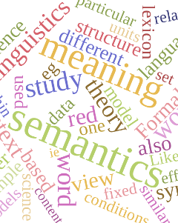
2. Epistemological principle: categorical semantics
Notes:
2. In order to solve the riddle of the detection of the intersubjective character of the categories of indexing knowledge and information, we exploit all the advantages offered by the categorical semantics. Categorical semantics are based on the definition of universal categories, that is facets and hierarchies, under which we subsume more specific terms. Having categorical semantics as a starting point we aim at defining the top-level-concepts (facets and hierarchies) under which the specific terms of every scientific domain could be subsumed. As Elaine Svenonius mentions, these universal categories or top-level concepts, pose an a priori validity in the realm of perception which is related to phenomena, and can thus be considered as “categories of existence”. This universal character of the facets and hierarchies could guarantee both the validity of the categories which constitute the thesaurus and the potential of the sustainable and manageable expansion of the thesauri into new areas of knowledge in which it continues to be effective and efficient.
But what are the criteria, more specifically, according to which we could define the facets and hierarchies in a way that the definitions become generally accepted, regardless of the subjective factor and the restrictions imposed by the field within which these facets and hierarchies will be applied? In order to answer this question we should proceed to the presentation of the third epistemological principle.

Slide 10

The extension of a term is defined as the set of items for which it is true. It denotes the reference of a term, the range of its applicability by naming the particular items.
For example, the extension of the term 'cat ' is the set of all the cats in the world; the extension of 'red' is the set of all the red things
Notes:
The third epistemological precondition that guides our effort has to do with the quality of the properties we attribute to the terms in order to define them. Following the distinction between the intension and extension of a term, the detection of the substantial properties we attribute to a term is based on its intensionality.
The extension of a term is defined as the set of items for which it is true. It denotes the reference of a term, the range of its applicability by naming the particular items.
For example, the extension of the term 'cat ' is the set of all the cats in the world; the extension of 'red' is the set of all the red things.
Nevertheless, if we define the terms according to their extension, we would not be able to define something that we do not already know or does not already exist. In order to express the meaning of a term we have to refer to its intensionality.

Slide 11
The intension of a term is the sum of its properties, state of affairs, qualities etc. that constitute the necessary and sufficient conditions for being in the extension of a term/concept
For example, the intension of "bachelor" might be something like: adult, unmarried male. Being an adult, being unmarried, and being male are all necessary conditions for being a bachelor, and their conjunction is a sufficient condition
Notes:
Roughly speaking the intension of a term is the sum of its properties, state of affairs, qualities etc. that constitute the necessary and sufficient conditions for being in the extension of a term/concept. In other words, it is the content of a term, its meaning.
For example, the intension of "bachelor" might be something like: adult, unmarried male. Being an adult, being unmarried, and being male are all necessary conditions for being a bachelor, and their conjunction is a sufficient condition.
However, the necessary and sufficient conditions of many concepts/terms cannot be detected only through the logical or analytical decomposition of their constituents. In order to solve this problem we have additionally to introduce the term conventional intension of terms.

Slide 12

Conventional intension
Notes:
Conventional intension of a concept/term consists of properties, state of affairs etc. which are commonly understood and accepted as denoting items belonging to the same extension. Conventional intensions are not merely the result of an (arbitrary) agreement between subjects. On the contrary, the intersubjective agreement on the conventional intensions is based on their reference to a known reality (Millikan, 2010), which exhibits some distinct forms than a logical determination. For instance, “Human being” is sufficiently known to us and distinct from other things, even without DNA analysis. But which are specifically the criteria upon which we commonly agree to use in order to define the properties of the concepts (intension) with a possible extension? For this purpose the methodological tools we use turned to be crucial.

Slide 13

Methodological preconditions and tools
Each concept has a purpose or utility
Notes:
A basic methodological prerequisite that we presuppose in our research is the belief that each concept has a purpose or utility. In order to detect the properties of a concept/term we want to subsume in our thesaurus, we need first of all to clarify the context within which the terms acquire their specific meaning. In order to analyze the function of a concept/term within its specific context of reference and detect its properties we apply the bottom-up method.
Bottom up method help us realize to which extend the meaning of a term is dependent from the context of use within which the term emerges each time. By pointing the restrictions of a specific context of reference, the bottom up method brings to light the properties resulting from the interpretation function and those derived from the term itself.

Slide 14

Bottom-up method
Notes:
2.Contrary to what one would expect the bottom up method not only does not restrict our approach concerning the meaning of a term but instead it brings to light the restrictions of the domain of reference itself and hence depicts the need to reflect the terms also independently of each specific domain of reference. In other words, it helps us to clarify which of the properties attributed to a term originate form the domain of its reference and which express the stable attributes of a term independently of the context of reference.

Slide 15
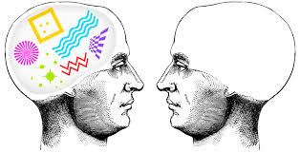
Abstraction from the context of reference
Notes:
3.The third methodological prerequisite that we presuppose in building a thesaurus is the process of abstraction of a term from the context of reference in order to clarify which of its properties are due to the specific context of reference and are in this sense accidental and which are permanent and attributed to the term independently from the context of reference. Thus through the process of abstraction we can distinguish between the incidental or context-dependent behaviors of the source terms and the intensional properties that express the stable attributes of the terms.
A very important result of the bottom up method and the abstraction process through which we disconnect a term from a specific context of reference and detect its intensional properties, is that we are gradually discovering its range and its links to broader concepts that may include the term as narrower. So we are step by step progressing to the formation of the upper-level concepts that meet the demands required by the material we have at our disposal, without projecting the upper level concepts on this material.

Slide 16
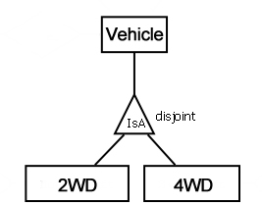
IsA relationship
The IsA relationship reveals
the common ground between narrower and broader terms.
Motorbike and truck: both are
Vehicles!
Notes:
4.Last but not the least methodological tool which we may apply in order to avoid categorical errors and contradictions in the process of indexing terms is to build relations between the terms according to the criterion of IsA relationship. The IsA relationship dictates that every hierarchy should obey the principle of subsuming narrower to broader terms so that the internal consistency of the terms will become clear and explicit. Hence the subsumption of a narrower under a broader term builds an inference that supports the inheritance of the properties of the broader term to all the instances of the narrower terms (IsA relationship).
The IsA relationship serves therefore as a logical control to avoid contradictions and categorical errors resulting from the subsumption of terms under facets or hierarchies, which have properties different than those of the indexed terms. The IsA relationship is thus a basic methodological tool in our endeavour to satisfy the demands of interdisciplinarity and transparency, which are the prerequisites for building a robust and reliable thesaurus that could be expanded to other fields of knowledge.. For example, through the IsA relationship we could recognize the properties that a motorbike and a truck have in common: both are vehicles and inherit the same intensional properties of this category.

Slide 17

How to recognize the intensional
properties of a term.
Notes:
PRACTICAL ADVICE: As a conclusion of this section devoted to the methodological restrictions and tools, we would like to present practical advice on how to recognize the intensional properties of a term.
A) The intensional properties cannot be replaced without loss of meaning.
B) The recognition of the intensional properties must be transparent and based on information accessible to everyone. For example, DNA, although a reliable evidence in order to recognize the human beings, is not accessible to everyone, while the morphological characteristics are! C) The detection of the intensional properties leads us to the top-level concepts, that is the facets and hierarchies. For example the broader category under which the term “mobile objects” can be subsumed, as revealed by its intensional properties, is that of “material objects”, since any mobile object must be a material object
D) The detection of the intensional properties brings to light additional properties, which we call potential properties, that could be the accidental properties of the narrower terms. For example from the intensional properties of the term “material object” which is weight and expansion we can conclude potential properties as shape, man-made, colour, dimensions etc
E) Intensional properties are qualitative and not quantitative, which means that we could differentiate concepts we use regardless of their way we use it in our everyday life in order to name specific particulars.

Slide 18

Practical rules and guidelines
Notes:
PRACTICAL RULES AND GUIDELINES Based on the above epistemological and methodological commitments we proceeded to draw some conclusions regarding the practical rules and the steps we follow in the process of building and designing a thesaurus.

Slide 19

Intensional vs incidental properties
  E.g.: if we define “human” as “driver” i.e. by his incidental property to drive a car, then all people who do not drive are not human!
Notes:
The definitions of the upper level concepts should be based on the intension of the concepts/terms and not on their extension. For example, if we define “human” as “driver” i.e. by his incidental property to drive a car, then all people who do not drive are not human!

Slide 20

  Contradictions
  Terms are defined through self-contradictory properties:
    E.g. conflicts are intentional activities carried out by at least two actors and are caused by natural phenomena!
Notes:
2. The arrangement of the top level concepts of thesauri and also any expansion of them, either horizontally (through the addition of new top-level concepts) or vertically (through the specialization of the existing ones), must follow the principle of exclusion of contradictions (clash-free expansion of the thesaurus).
Below are some of the examples that show kinds of contradictions we encountered in the environment of controlled vocabularies:
A) Terms are defined through self-contradictory properties:
E.g. conflicts are intentional activities carried out by at least two actors and are caused by natural phenomena!
! Here, the contradiction lies in the fact that we define the term both as the “intentional actions carried out by at least two actors” and at the same time as situations resulting from natural phenomena.

Slide 21
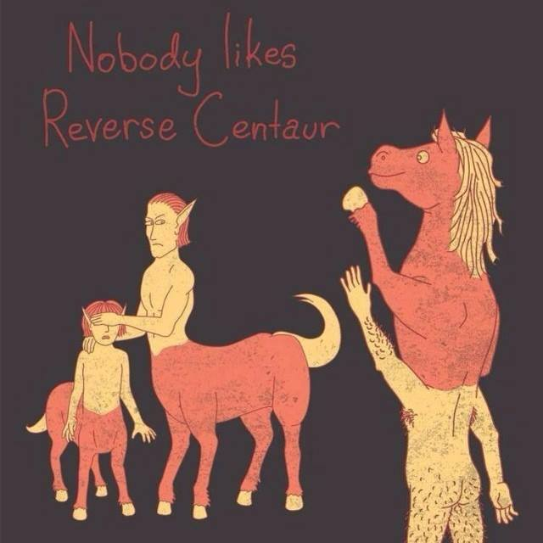
Reverse of the relation between broader and narrower term.
  E.g.: Stelae, which is a concrete piece of stone bearing inscriptions that can be transferred is the broader than the term “mobile objects” which comprises any object that can be transferred!
Notes:
b) Reverse of the relation between a broader and a narrower term. A broader term A is subsumed under a narrower B, which implies that the narrower term B has less properties than the broader term A. for example.: Stelae, which is a concrete piece of stone bearing inscriptions that can be transferred is the broader than the term “mobile objects” which comprises any object that can be transferred!
! Here the contradiction lies in the fact that, the narrower term (mobile objects) does not necessarily inherit all the properties of the broader (Stelea).

Slide 22
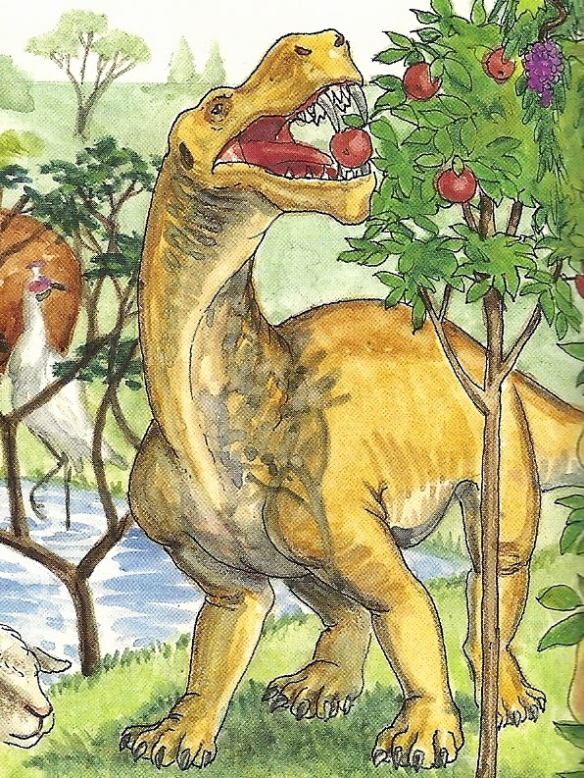
A narrower term is attributed properties which contradicts at least one of the necessary properties attributed to its broader term.
  E.g.: if we subsume the term Stelae which is a mobil object under the broader term immobile objects, then “Stelae” seems to posses contradictory properties: it can and cannot be transferred!
Notes:
A narrower term is attributed properties which contradicts at least one of the necessary properties attributed to its broader term.
E.g.: if we subsume the term Stelae which is a mobile object under the broader term immobile objects, then “Stelae” seems to posses contradictory properties: it can and cannot be transferred!

Slide 23
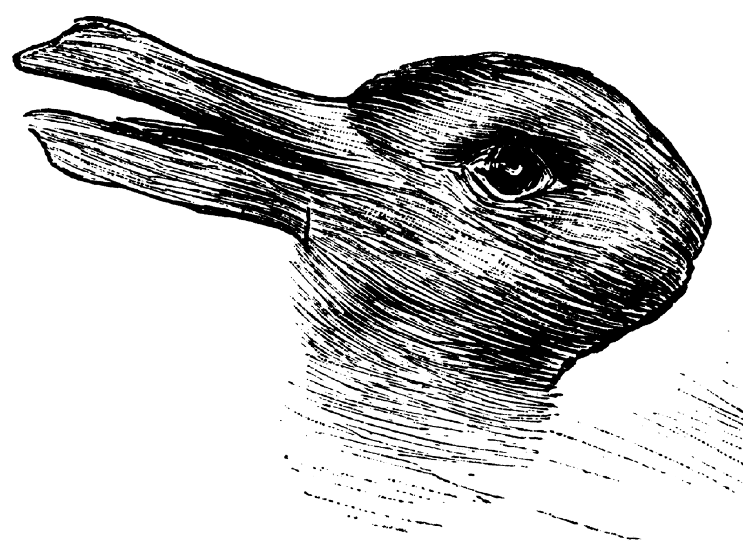
Avoid ambiguity: Duck or Rabbit?
Notes:
In defining the upper level concepts, both the semantic and syntactic ambiguity and vagueness should be avoided. In other words, an expert should be able to decide if some item of his discourse is an instance of the term or not. In building and designing thesauri we often encounter two kinds of ambiguity and vagueness.

Slide 24

Avoid too broad concepts.
  E.g. If we choose for an upper-level concept the term “research object”, we could subsume under this concept the whole thesaurus!
Notes:
a) ambiguity related to the detection of the upper level concepts we define in order to subsume the material we have at our disposal. If the meaning of the upper level concepts is too broad and relative it could comprise any kind of items without any semantic contiguity or relation.
E.g. If we choose for an upper-level concept the term “research object”, we could subsume under this concept the whole thesaurus! Practically that means that we cancel our effort to classify knowledge.

Slide 25
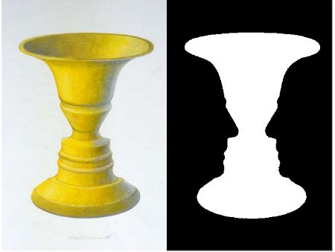
Ambiguity related with the polysyme of the terms
  Ε.g. Mercury could mean: a metal, a planet, a God in mythology
Notes:
b) ambiguity related to the polysemy of a term: a term could have multiple, incoherent meanings related to the semantic field (context) they refer to. When you deal with terms with multiple meanings, first you have to clarify the domain of reference, in order to disambiguate and define the term appropriately. If necessary, you could add a “word” that would determine the term properly and differentiate between its multiple meanings. Ε.g. Mercury could mean: a metal, a planet, a God in mythology. Therefore, before classifying the term we have to clarify the context in which we find the term in order to disambiguate it.

Slide 26

Identify the common meaning between the terms.
  Ε.g. if we define wars as “armed conflicts” we exclude all the other forms of war that are not based on weapons”.
Notes:
4. The definitions of the target terms should allow us to identify the common meaning and not the boundaries between the terms. Ε.g. if we define wars as “armed conflicts” we exclude all the other forms of war that are not based on weapons”.

Slide 27

Avoid introducing upper level concepts whose meaning is tied to a specific context.
E.g. X-Ray systems are used by many disciplines, such as medicine, material assaying, art conservation, archaeology. Classifying them as “medical instruments” or “archaeological instruments” would not render anything about their nature.
Notes:
5) Avoid introducing upper level concepts whose meaning is tied to a specific context. The definitions of the upper level concepts should not be limited to or dependent on a specific context of use. E.g. X-Ray systems are used by many disciplines, such as medicine, material assaying, art conservation, archaeology. Classifying them as “medical instruments” or “archaeological instruments” would not render anything about their nature.

Slide 28
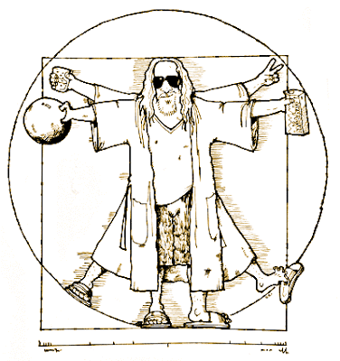
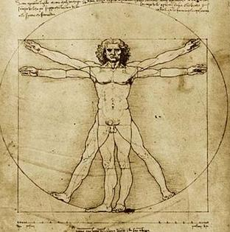
Distinguish between universals and particulars.
  E.g. the term ethnic groups is a specialization of groups because they designate a specific type of groups based on the origins of people, while the term Germans is not a specialization of groups, which establish a type of a group but a realization of a certain type of group which is based on the differentiation according to the (geopolitical etc.) origins of certain people.
Notes:
Distinguish between universals and particulars. The confusion between them could lead to inconsistencies and logical errors that could be an obstacle to the expansion of the thesaurus. In order to differentiate between universals and particulars you have investigate if the term you insert represents a type as a specialization of the broader concept under which it is subsumed. E.g. the term ethnic groups is a specialization of groups because they designate a specific type of groups based on the origins of people, while the term Germans is not a specialization of groups, which establish a type of a group but a realization of a certain type of group which is based on the differentiation according to the (geopolitical etc.) origins of certain people

Slide 29
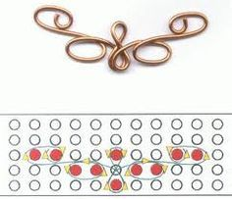
The definition should correspond to the term and vice versa.
  E.g. it is easy to get carried away by the affinity of the meaning and consider the term “distribution of roles” as a narrower term of the facet “groups and roles. But Distribution/allocation of roles is an action and there is a contradiction between the facet and the narrower terms!
Notes:
When you define a term you have to be careful with the definition, so that the definition corresponds to the term and vice versa. E.g. it is easy to get carried away by the affinity of the meaning and consider the term “distribution of roles” as a narrower term of the facet “groups and roles. But Distribution/allocation of roles is an action and there is a contradiction between the facet and the narrower terms! In case that it is required a hierarchy that denotes the distinction of the roles of members of a social group, you have to look for another concept with a suitable definition.

Slide 30

Define a concept/term according to the contemporary terminology we use to describe it.
  E.g. according to the contemporary approach of architecture it is a science while according to an earlier approach architecture is handwork.
Notes:
Define a concept/term according to the contemporary terminology we use to describe it.
E.g. according to the contemporary approach of architecture it is a science while according to an earlier approach architecture is handwork.

Slide 31

The names you choose in order to express the meaning should not lead to ambiguities and confusions with other terms.
  E.g. Although the term “book” is a material object we frequently use the term to denote the content of the book which is however a conceptual object.
Notes:
You have to be careful with the names you choose in order to express the meaning you want to ascribe to a term. The names should not lead to ambiguities and confusions with other terms.
E.g. Although the term “book” is a material object we frequently use the term to denote the content of the book which is however a conceptual object.

Slide 32
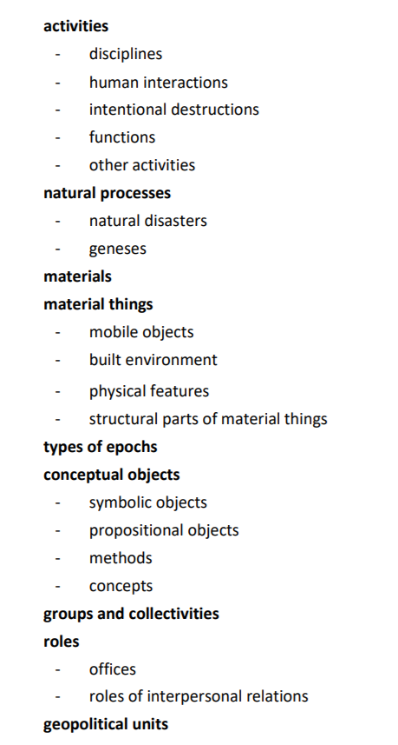

http://backbonethesaurus.eu

