Slide 1

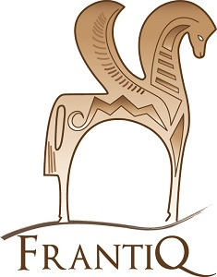

Using the DARIAH's BackBone Thesaurus as a filter for the reorganisation of the PACTOLS thesaurus
DARIAH Working Group Open Meetings 2021 - Thesaurus Maintenance WG, 18 nov. 2021
Blandine Nouvel
(Aix Marseille University, CNRS, Centre Camille Jullian, Aix-en-Provence, France)
Notes:
Good morning everybody.
Thank you to Helen for her tribute to Evelyne, with whom I have embarked on an adventure that I would like to share with you today.
My name is Blandine Nouvel, I work as a research engineer at the CNRS. For several years now, my work has consisted of providing the French archaeological community with documentary tools for the reporting and dissemination of scientific resources.
In this presentation, I would like to show you the original way in which Frantiq uses the DARIAH BackBone thesaurus to help reorganise its PACTOLS thesaurus.
Frantiq is a federation of 45 French research centres, belonging to the CNRS, universities and local authorities, all involved in archaeological research. Among the tools we have developed since 1985 is the PACTOLS thesaurus.

Slide 2
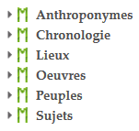
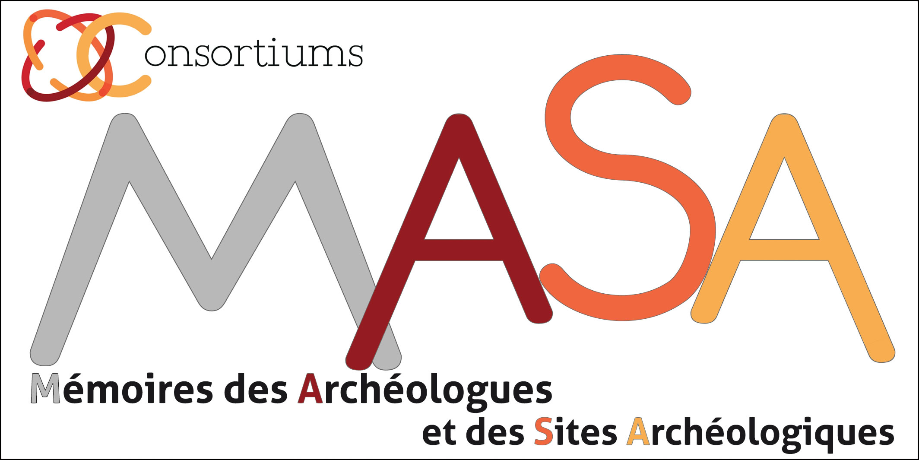

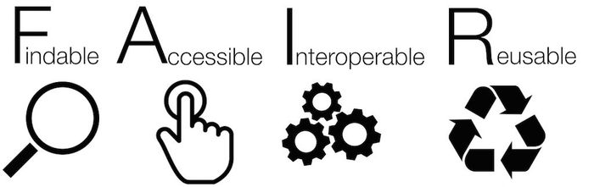
The PACTOLS thesaurus
Thesaurus for Archaelogy and Antiquity
Created in 1987 by FRANTIQ
60.000 concepts
6 micro-thesauri/collections
6 languages
Reorganisation programme, 2017-2022
Free, Normalised, Citable
To consolidate the structure To enrich the vocabulary
Supported by Consortium MASA
Led by Project Team
https://pactols.frantiq.fr
Free license ODbl
ISO 25964
Ark & Handle Identifiers
SKOS, Json, RDF
Rémi Ancel (Service archéologique du Val de Marne)
Pascale Araujo (SRA Centre Val de Loire)
Emmanuelle Bryas (Inrap)
Véronique Humbert (CNRS-ASM)
Marie Lakermance (DRASSM)
Magali Lugnot (CNRS-Maison de l’Orient et de la Méditerranée)
Patricia Moitrel (SRA Normandie)
Christelle Molinié (Musée Saint-Raymond)
Emmanuelle Piredda (CNRS-Maison de l’Orient et de la Méditerranée)
Miled Rousset (CNRS-Maison de l’Orient et de la Méditerranée)
Justine Vincent (Inrap)
Updates
Diversified Uses
Ongoing but irregular
Contains obsolete or incomplete vocabulary
Frantiq collective catalogue
Scientific journals
Research databases
Cultural heritage promotion
Notes:
This controlled vocabulary covers all fields of archaeology, from prehistory to the present day, and classic studies.
It is organised in 6 eponymous collections and constitutes a unique repository of multilingual concepts. It access is open and free. It is managed with the Opentheso software. it is in compliance with ISO standard and SKOS, polyhierarchic, citable (using ARK) and under free license.
Its lexical richness and normative qualities have made it an essential resource for the construction of open and interoperable resources for French archaeology. It is used by libraries, publishers, data producers and for the promotion of archaeological heritage.
Despite continuous updates, its structure had not evolved since its creation and it had organisational defaults which made it difficult to manage, particularly when new concepts were added. In addition, its lexicon was incomplete on certain subjects and sometimes outdated. This threatened its dissemination and potential alignment with the semantic web repositories.
With Evelyne and a small team, we therefore launched a reorganisation programme which was supported by the MASA consortium, Memory of Archaeologists and Archaeological Sites. This programme aims to consolidate its structure, in particular conformity with the SKOS language, and to enrich the vocabulary in partnership with experts in the various fields of archaeology.

Slide 3

Reorganising the structure of PACTOLS
An unconvincing first experience
The discovery of the BBT, a magic solution
  Conceptual categories = New approach to collections
  Limited number of levels = Simplicity and visibility model
  Alignment with CIDOC-CRM = Opening to LOD
  Scalable and collaborative
Notes:
In our project, the discovery of the BBT was magical.
Indeed, at first, we had tried to revise the thesaurus collections by focusing on the Subjects one. The aim was to simplify the branches and make them more readable. But we were not satisfied, we wanted a more radical transformation.
The BBT was the solution: its conceptual categories allowed us to consider a different approach to collections. The limited number of hierarchical levels offered us a model of simplicity in display and better visibility of the topics covered by PACTOLS. Its similarity to the CIDOC-CRM ontology met the objectives of interoperability and openness to other data repositories.
Scalable and collaborative, we decided to participate to its updates

Slide 4
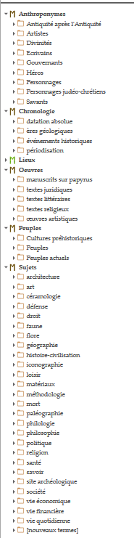
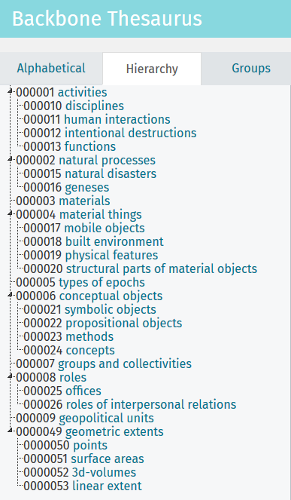
Using the BBT facets as a filter
By creating a temporary BBT tree with additional lower levels, named Pactols2
By distributing PACTOLS concepts in the BBT categories, field by field
By reorganising the contents systematically
By correcting structural inconsistencies and confusion of categories in the branches
By revising the entire vocabulary
Notes:
We therefore decided to use the BBT as a filter to redesign the PACTOLS collections..
We have created a temporary tree with the BBT facets in the Opentheso software with a copy of the PACTOLS thesaurus. That we named Pactols2
Then we redistributed each concept in the BBT structure, field by field, starting with the Subjects collection. This forced us to correct structural inconsistencies and confusion in the branches.
We have reviewed the meaning of some concepts, with particular attention to definitions and translations.
In the end, this is an opportunity to update the whole vocabulary, which was one of the aims of the programme

Slide 5
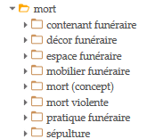
The game of deconstruction / reconstruction, one example
… and in PACTOLS v2
BBT-Activities
BBT-Human interactions
pratiques funéraires
rituel funéraire
BBT-intentional destructions
mort violente
BBT-natural processes
BBT-geneses
mort (biologie)
BBT-material things
BBT-mobile objects
contenants funéraires
mobilier funéraire
BBT-built environment
[complexe bâti par fonction]
espace funéraire et mortuaire
[unités bâties par fonction]
édifice funéraire
aménagement de la tombe
marqueur de tombe
monument funéraire
sépulture
entités biologiques
restes humains
BBT-conceptual objects
  BBT-methods
traitement du cadavre
BBT-propositionnal objects
mort (concept)
Death in PACTOLS 1
1 specific file
133 concepts
Creation of additional levels
Redefinition of concepts
Updating and augmenting vocabulary (176)
Permanent checking by experts
Notes:
In that game of deconstruction/reconstruction, Let’s take the example on the Death file.
* In the original PACTOLS, the Death file included 133 concepts in 8 sub-branches. Distribution of the terms was prepared on a shared spreadsheet with the BBT categories completed if necessary with additional hierarchic levels. Once validated, that tree was entered in the PACTOLS 2 until the Death tree was emptied.
* The concepts of the Death hierarchy are now divided among 5 new categories and 11 new subdivisions which are better integrated into the other domains of the thesaurus.
The revision process put an emphasis on the vocabulary : outdated terms were either renamed or merged, sometimes deprecated, and definitions were updated with recent bibliographic sources. The revision of certain terms will lead us in the future to correct the indexing of the Frantiq Collective Catalogue to keep its connection with the PACTOLS thesaurus.
We have worked under the control of funerary archaeologists and anthropologists eager to be involved in the creation of a terminology they had been trying to formalise for many years.

Slide 6
8 months before the new release
About concepts
Only 800 concepts left in the Subjects collection to be filtered
Enrichments
  75% of concepts have a definition
  Add numerous skos:altLabel
  More related terms
2500 new concepts
140 concepts deprecated for obsolescence
And all PACTOLS collections are ultimately impacted
Notes:
The situation with 8 months to go before the delivery of version 2,
* concerning the update of the concepts
there are still 800 concepts to be processed out of the original 6800 in the Subjects section.
We have increased the number of definitions to 75% of the concepts with a definition,
added variants to the labels,
created links with concepts from other branches and collections.
Created 2500 two thousand five hundred concepts
deprecated 140 hundred and forty concepts
And of course, all PACTOLS collections are ultimately impacted

Slide 7
8 months before the release of v2
About structure
From BBT to PACTOLS 2,
first proposal with ex. Material things
A hierarchy limited to 5 levels with the introduction of facets
Redistribution of large categories (activities, material objects, conceptual objects,...)
Rearrangement of existing categories into 15 to 20 new entries,
Customisation of headings in progress,
Keep track of equivalent categories with BBT facets and CIDOC-CRM classes
BBT Material things
P2 Buildings
P2 Mobile objects
Built complexes
Infrastrucutres
Built units
Objects
Structural part sof mobile objects
Structural parts of buildings
P2 Physical features
Notes:
*Concerning the structure,
We Disperse the largest categories among more accessible files thus limiting the depth to five levels when there were up to 11 eleven ! with the introduction of facets. This will provide a more direct access to the contents (2661 material entities > 800 built environment ; 1269 mobile objects)
Add approximately 15 fifteen new top terms (that is terms on the 1st level) merging current PACTOLS micro thesauri and BBT facets. This will eliminate the 6 former PACTOLS micro thesauri and introduce the new categories : agents, buidings, chronology, disciplines, space and territory, living organisms (flora and fauna), languages, materials, mobile objects, works of the mind, society and techniques…
We started to customise headings in clear and understandable language for all users.
And make sure that we keep track of the equivalent files and sub-files of the BBT Facets and CIDOC CRM classes
Here is an example with the category Material things of which we retain only levels 2 and 3 by rearranging them
Almost ready to upload the PACTOLS concepts into the BBT

Slide 8

Thank you all
blandine.nouvel@frantiq.fr

