Slide 1

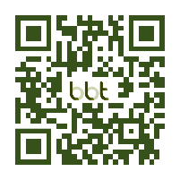
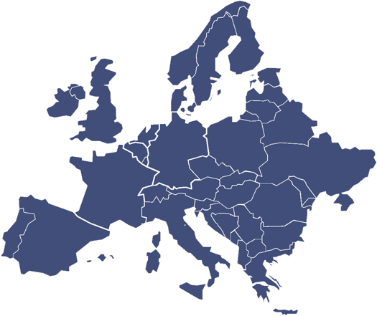
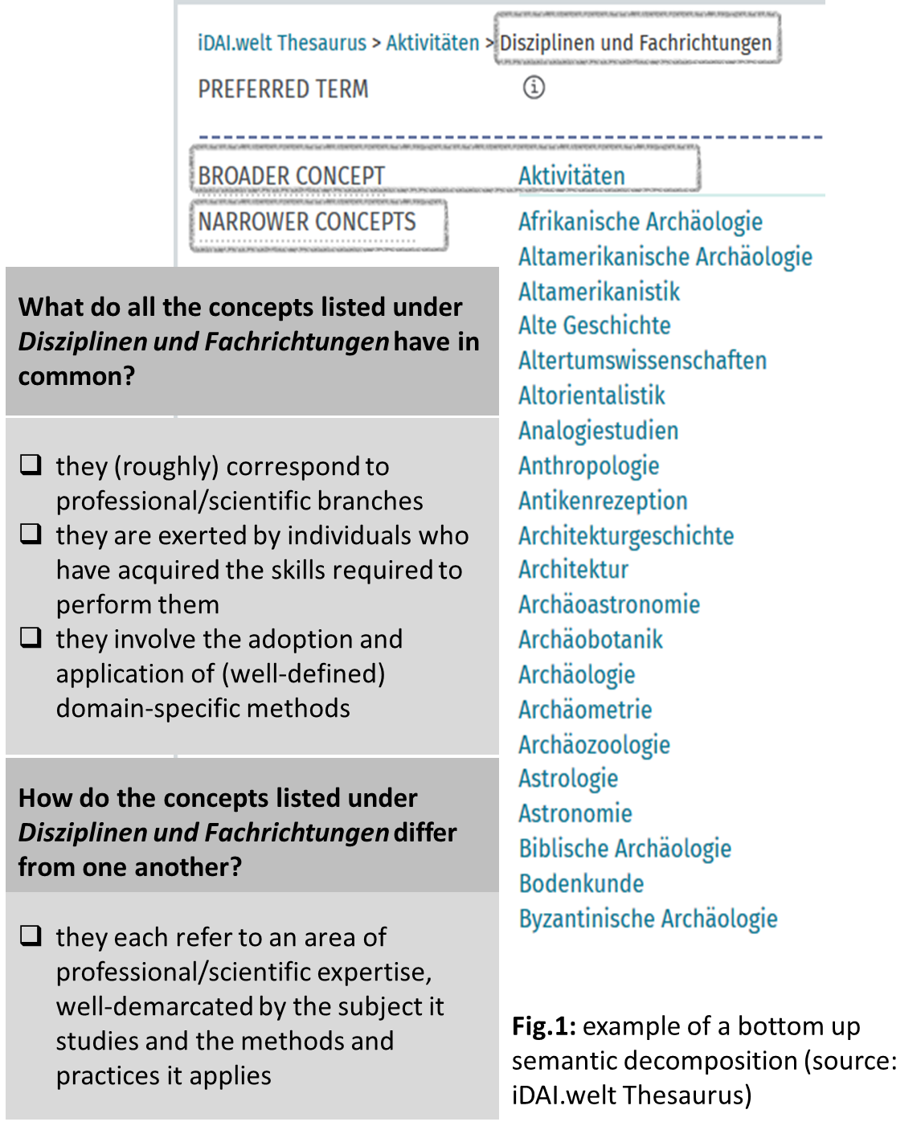
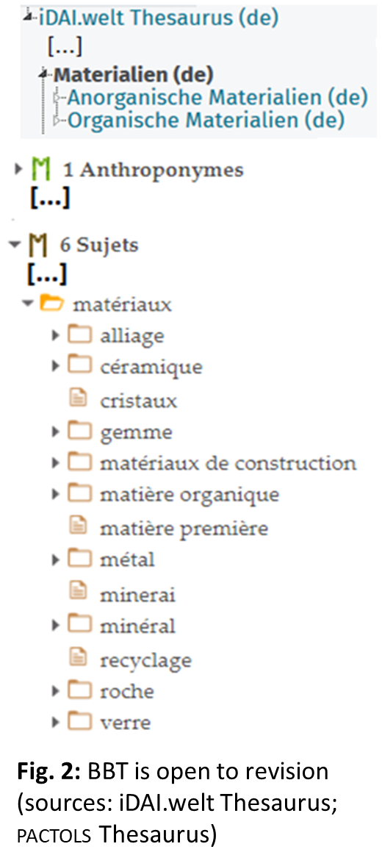
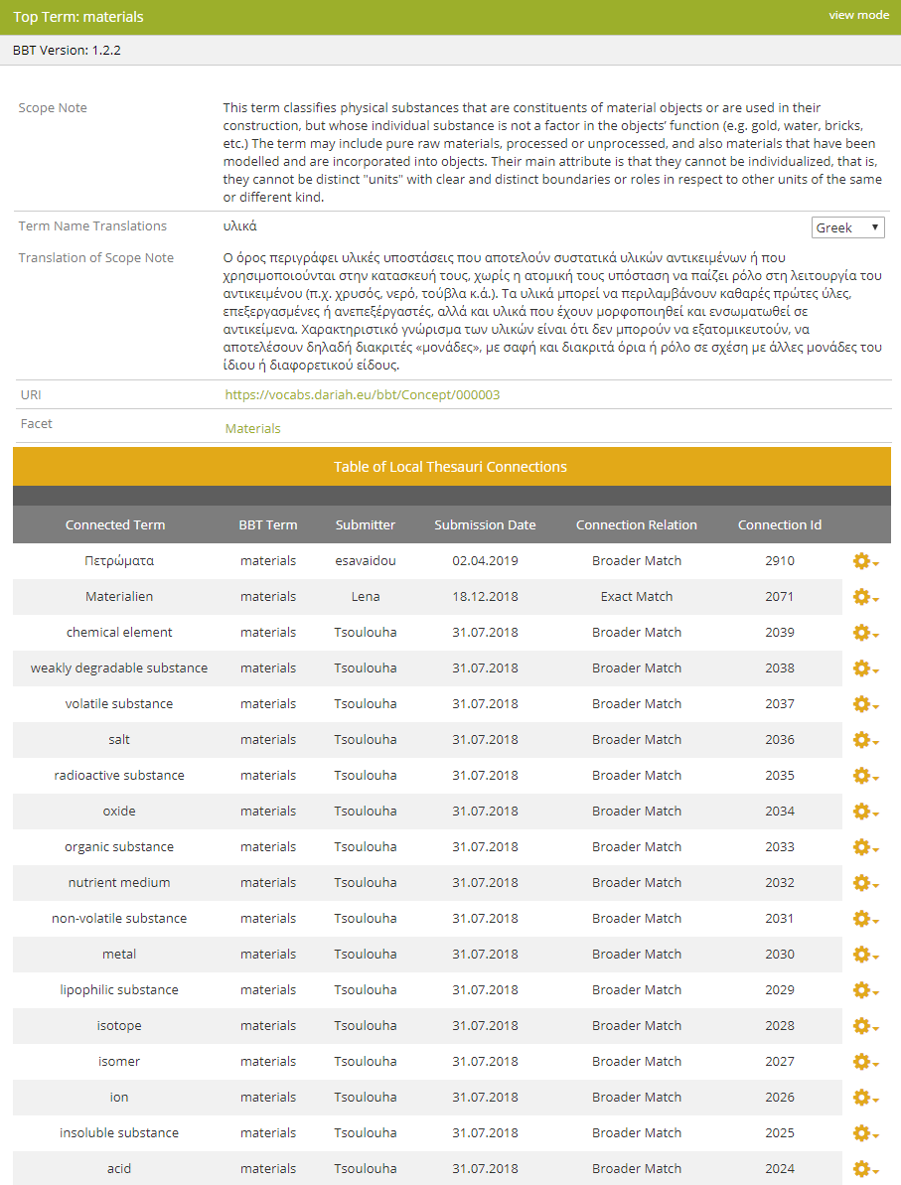
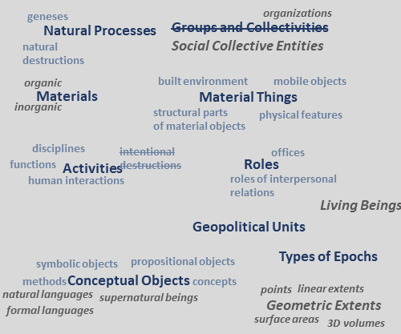
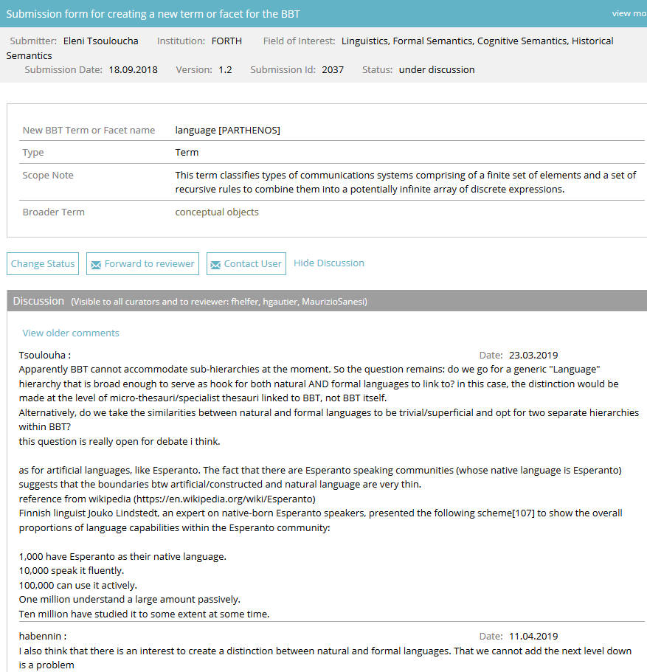



The BackBone Thesaurus (BBT):
Evolving a meta-thesaurus for the humanities through
collaborative, distributed thesauri maintenance and development
E.Tsoulouha [1], H.Goulis [2], G.Bruseker [1] [1] ICS-FORTH, [2] Academy of Athens
BBT in a nutshell
The BBT^{[1]} is the research outcome of work undertaken by the DARIAH Thesaurus Maintenance WG^{[2]} in an effort to design and establish a coherent overarching thesaurus for the humanities, under which specialist thesauri and structured vocabularies used across scholarly communities can be aligned and form a thesaurus federation.
It aims at enabling cross-disciplinary resource discovery while ensuring compatibility with thesauri that cover highly specific scientific domains and areas of knowledge in development.
It is constructed and maintained collectively by a distributed group of DARIAH affiliated organizations (AA,^{[3]} DAI,^{[4]} FORTH,^{[5]} FRANTIQ ^{[6]}).
^{[1]} www.backbonethesaurus.eu, ^{[2]} www.dariah.eu/activities/working-groups/thesaurus-maintenance,
^{[3]} www.academyofathens.gr, ^{[4]} www.dainst.org, ^{[5]} www.ics.forth.gr, ^{[6]} www.frantiq.fr
Methodological principles: The design of BBT
BBT makes use of a small number of high-level concepts (facets & hierarchies).
BBT facets and hierarchies were obtained through a bottom-up analysis of classificatory systems used by humanities researchers [Fig. 1].
  Only the intensional properties of the specialist thesauri concepts were taken into consideration for the definition of BBT high-level concepts.
  BBT concepts are completely disjoint from one another and are divided in:
        FACETS: mutually exclusive high-level concepts that appeal to general categories of human perception
        are to some extent “objective” and valid from a cross-disciplinary perspective.
        HIERARCHIES: stand in a hierarchical isA relation to their respective top terms
        are differentiated among them by at least one salient intensional feature.
BBT assumes an open-world position: facets and hierarchies within them do not exhaust the domain they classify.
BBT is deliberately open to revision [Fig. 2].
BBTalk: A tool for federated thesaurus management
BBT aims to bring together a federation of vocabularies spanning the Arts and Humanities and to render them interoperable.
BBTalk ^{[7]} is an online service for managing thesauri integration with the BBT and updating its content, when necessary.
BBTalk offers a thesaurus alignment functionality allowing end users:
  create links among specialist thesauri and the BBT [Fig. 3].
  provide evidence confirming/disconfirming the high-level terms of the thesaurus itself.
Clashes between BBT concepts and thesauri aligned to it can be resolved by updating the content and/or structure of the BBT [Fig. 4].
Updating the BBT involves the introduction of new high-level terms plus the deletion/merging or splitting of existing ones.
  BBTalk keeps track of such actions and allows for version control.
Changes are implemented after careful consideration and discussion among the BBT managing team, until consensus is reached.
  BBTalk supports discussions among end-users and its managing team [Fig.5].
BBTalk supports multilingual content.
  BBT content is now available in English, French, German and Greek.
^{[7]} https://www.backbonethesaurus.eu/BBTalk/
Fig. 4: overview of the BBT concepts and proposed changes
Fig. 3: links to BBT top-term “materials”
Fig.5: discussing a proposed change
REFERENCES: Daskalaki M. & Charami L. (2017). A Back Bone Thesaurus for Digital Humanities, ERCIM News 111, October 2017, Special theme: Digital Humanities , ERCIM News 111, October 2017 URL; Doerr M., & Kalomoirakis D. (2000). A Metastructure for Thesauri in Archaeology. Ljubljana, Slovenia, 18-21 April. BAR International Series 931, Archaeopress, Oxford, 117-126; Georgis Ch., Bruseker G., & Tsouloucha E. (2019). BBTalk: An Online Service for Collaborative and Transparent Thesaurus Curation, ERCIM News 116, January 2018, Special theme: Transparency in Algorithmic Decision Making , ERCIM News 116, January 2018, URL; Murphy G. (2002). The big book of concepts. Cambridge, MA: MIT Press; Svenonius E. (2003). “Design of Controlled Vocabularies”, in: Encyclopedia of Library and Information Science, DOI:10.1081/E-ELIS 120009038, New York, 822-838; Thesaurus Maintenance Working Group, VCC3, DARIAH EU. (2015). Thesaurus Maintenance Methodological Outline. Greece. Retrieved from http://www.backbonethesaurus.eu/sites/default/files/workingpaperonthesaurusmaintenance29_05_2015.pdf.
DARIAH Annual Event 2019: Humanities Data
www.dariah.eu | dariah-info@dariah.eu | @DARIAHeu
This work is licensed under a
Creative Commons Attribution
4.0 International Licence

