Slide 1



Integrating PACTOLS into the BBT
A challenge and opportunity for change
Dariah Annual Event
Thesaurus Maintenance WG Meeting
Warsaw, 17th May 2019
Notes:
Good afternoon everybody
For those who don’t know us we are Blandine Nouvel and Evelyne Sinigaglia both coordinators of the PACTOLS thesaurus Working Group
We have also recently joined the BBT Thesaurus Maintenance WG
Today we will start by a very short presentation of the PACTOLS Thesaurus on a single slide
Then we will present feedback on the organisation of the Recreation branch using the BBT categories
Finally we will ask questions that emerged from the PACTOLS WG meetings about terms that seem problematic.

Slide 2

PACTOLS : an archaeology thesaurus www.pactols.frantiq.fr
Created and developed by FRANTIQ / CNRS
  6 topics for archaeology.
Multilingual
Standardised : SKOS, ISO25964
Managed by free thesaurus management software Opentheso
Interoperable : URI Ark, API
Compatible with the FAIR principles
Used by and maintained in a collaborative workflow by :
  - Librarians for cataloguing
  - Publishers of scientific journals for indexing articles
  - Archaeologists for building databases
Notes:
Here is everything you need to know about PACTOLS :
It is an archaeology thesaurus.
It covers archaeology from prehistory to the contemporary period. It also covers sciences related to Antiquity.
PACTOLS was created in 1987 by the Féderation Ressources sur l’Antiquité
Its name is an acronym for its 6 thematic components :
1. Peuples (Peoples): ancient and modern peoples. These include prehistoric cultures : Spartans, and also the Magdalenian culture
2. Anthroponymes (Anthroponyms): kings, philosophers, artists but also deities
3. Chronologie (Chronology): absolute dating, geological eras, periodization and historical events
4. Toponymes (Toponyms) : names of place that are smaller than a village, for example archaeological sites, hamlets and caves
5. Œuvres (Works) : classic literature, works of art, and also religious texts
6. Lieux (Places) : Modern and ancient place names, physical geography (like oceans and rivers) and also imaginary places like Tartarus
7. Sujets (Subjects)

Slide 3
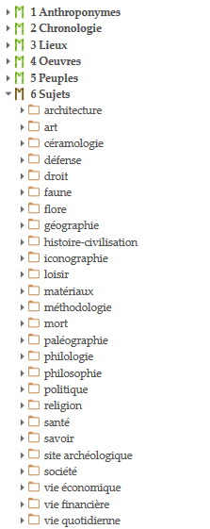
PACTOLS : a thematic thesaurus
A scheme to turn PACTOLS into a specialized repository of metadata for the semantic web
  Consolidate the structure
  Enrich the vocabulary and relationships between terms and the vocabulary
  Facilitate matching with online metadata repositories
Notes:
As you can see PACTOLS is a thematic thesaurus.
This kind of organisation is sometimes lacking in consistency… Those inconsitencies have led us to reorganise PACTOLS
A complete redesign programme was launched in 2017 in order to turn the PACTOLS thesaurus into a specialised repository of metadata for the semantic web.
Our plan for the next five years is :
To consolidate PACTOLS according to the rules of ontologies
To enrich relationships between terms, particularly by developing associative and equivalence relationships
To restore balance between thematic fields
To enrich the vocabulary by including specialised concepts, with synonyms and non-preferred terms, as well as their translations
To facilitate matching with online metadata repositories particularly Wikidata / Wikipedia and GeoNames. There has already been an partial alignment of the Subjects micro thesaurus carried out in the context of the ARIADNE infrastructure.
During our work we had the chance to get acquainted with the BBT during the Dariah Annual event 2018.
- Using the BBT would be an opprtunity to free us from thematic organisation and would be a step towards a more conceptual framework.
- Taking part in a federation of thesauri would imply collaborative work and exchange of experience and information.

Slide 4
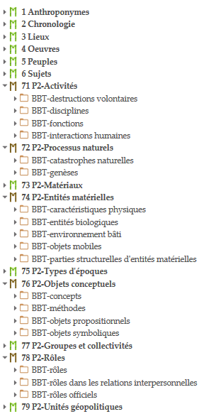
Integrating the BBT into Opentheso
PACTOLS, public version
PACTOLS, work in progress version
Notes:
To use the BBT categories we integrated them into our thesaurus management software. We then moved concepts by hand to the new categories.

Slide 5
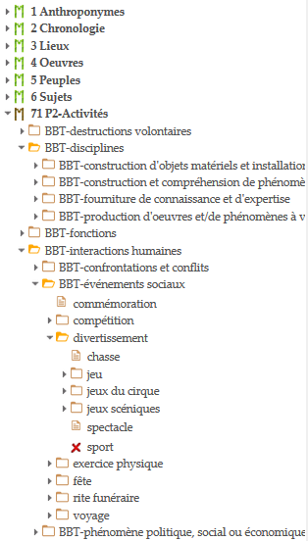
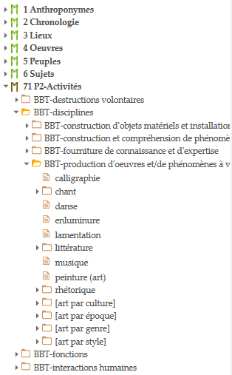
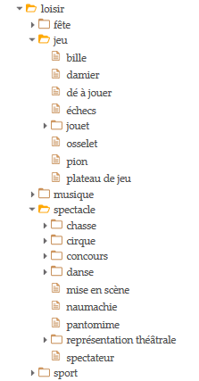
Divertissement / Recreation formerly Loisir = Leisure ?
Notes:
One the the first branches Blandine and I tried to integrate into the BBT was Loisirs
You can already see a problem of translation : loisir being recreation rather than leisure time. Loisir is an activity whereas leisure is time off work
So we replaced Loisir by divertissement

Slide 6
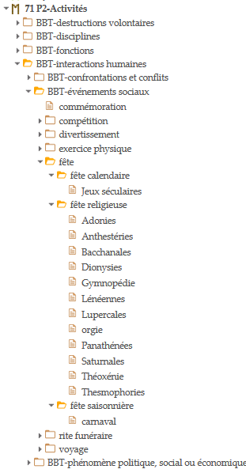
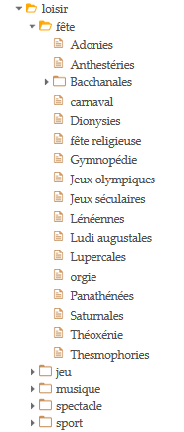
Fête / Festival
Religious festival
Orgy
Carnival
Notes:
We categorised Fête / Festival under Activities - Human interactions as you can see here
We tried to reestablish a logic in the structure : for example, Carnival, Religious festival, even orgy… are on the same level

Slide 7

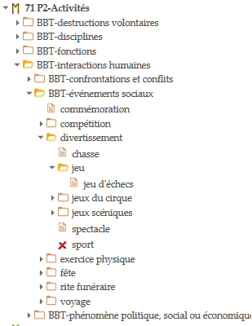
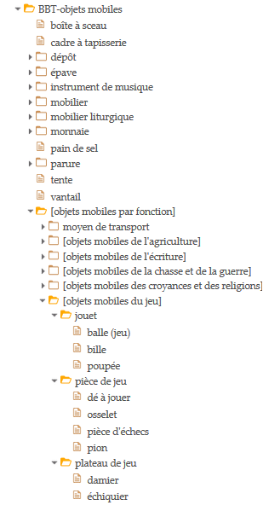
Jeu / Game
Notes:
Under Jeu / Game there were objects used in games. We sent these directly to the Mobile objects category

Slide 8
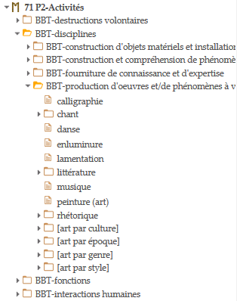
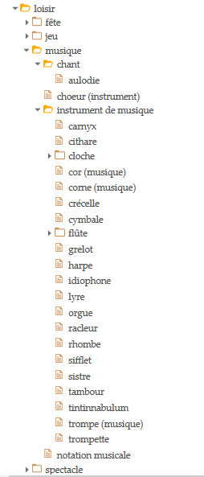
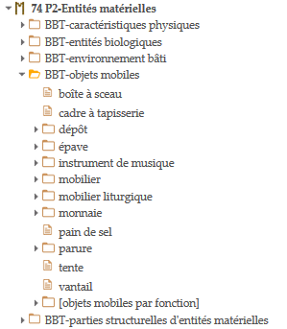
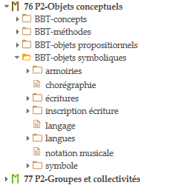
Musique / Music
Notes:
Same thing with Instruments de musique / Musical instruments : they were moved to Mobile objects
Notation musicale / Musical notation was placed under Symbolic objects
Chant / Singing was placed under Activities – Disciplines - Production of works and/or phenomena of aesthetic value

Slide 9
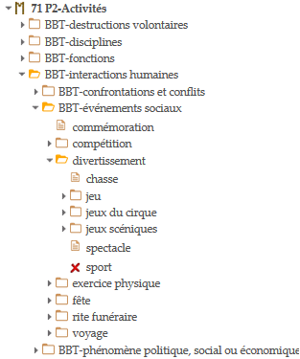

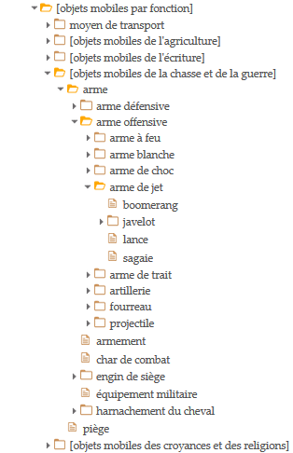
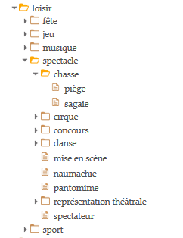
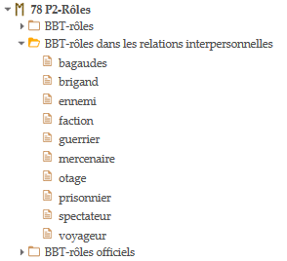
Spectacle
Notes:
Spectacle / Entertainment is now under Social events – Divertissement
Chasse / Hunting (here in the sense of Venatio) is under Activities – Human interactions
Under Chasse / Hunting, we had Trap and Spear which were moved to Mobile objects
Spectateur / Spectator is now under Roles – Roles of interpersonal relations

Slide 10
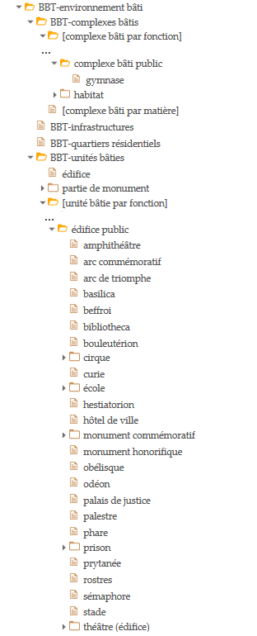
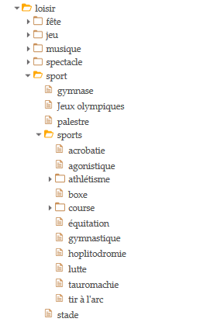
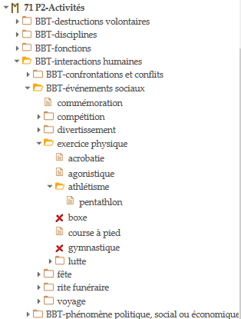
Sport (now Physical Exercise)
Notes:
In Sport / Physical exercise
Gymnase / Gymnasium and Stade / Stadium, Palestre / Palaestra were sent to Built environment
There was Sport in general and Sports under which you could find gymnastics, athletics and others
We got rid of the second level

Slide 11

Some questions raised during the work process :
Sacrifice : Role or Function ?
Teaching : Function or Method ?
Shipwrecking : Natural disasters or Human interactions ?
Archaeological site : Physical feature, Built environment or Propositional object ?
Notes:
Other members of the WG are currently dispatching branches of PACTOLS into the BBT : Palaeography, Architecture, Bone industry, Archaeological sites, Natural Processes and Materials
Questions that were raised include :
Sacrifice : is it a Role or is it a Function ?
A wider question could be asked about rituals
Enseignement / Teaching : should this appear in Functions or Conceptual object - Methods
Should shipwreck appear under natural disasters ?
Should archaeological site be included under : Physical feature, Built environment or Propositional object

Slide 12
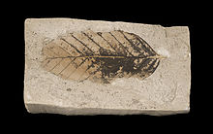
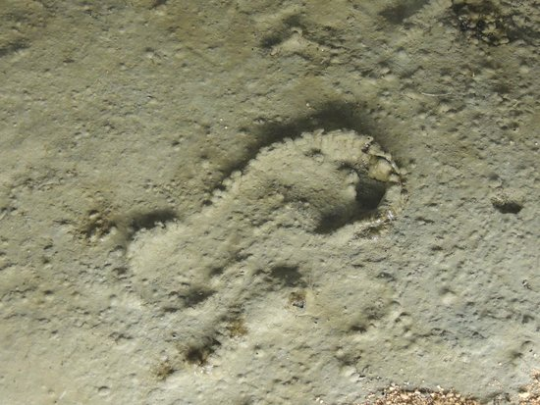
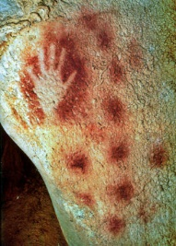
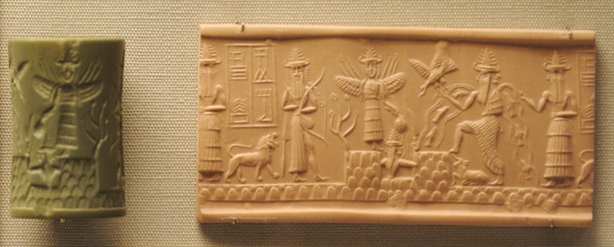
Empreinte / Impression ?
Could it be a
  Physical feature
  Structural part of material objects
  or even Symbolic object
Negative hand
Leaf fossil
Cylinder Seal impression
Footprint
Notes:
13.
Empreinte / Impression is also problematic :
The question here is whether it should appear under
Physical feature
This term classifies specific formations that are integrally adapted to certain material objects. They cannot, therefore, be separated from the carrier-object, but they also do not identify with it, since it is only a part of the carrier-object that carries the entire feature. In this sense, the feature is fixed, with respect to the carrier-object, while any attempt to remove it will result in the loss of part of the carrier-object. They may have two- or three-dimensional geometric extent, but there are no natural borders that separate them completely, in an objective way from the carrier-objects. Instances of Physical Features can be features in a narrower sense (scratches, holes, reliefs, surface colours etc.), while in the wider sense, they are portions of particular objects with borders that are not absolutely defined, such as the core of the Earth or the head of a marble statue.
Structural part of material objects
This class classifies objects especially constructed to be parts of a complex material object. These objects have autonomy in relation to the complex object of the appropriate type, to which they are intended to be added. Despite their autonomy, however, they are not independent in terms of their intended function, but are structural parts of the object, ie they have a specific function within the module to which they belong and which they form.
Note: The structural parts of the material things are not considered narrower terms of the aggregation to which they belong.
or even Symbolic object
This term classifies identifiable symbols and/or any aggregation of symbols, that have an objectively recognizable structure and that are documented as single units (sets or arrays of signs). Symbolic objects may serve to designate something, or to communicate some propositional content, but they don’t depend on what they designate or communicate. They can exist on one or more carriers simultaneously without this feature adding to or removing from the identity of the symbols. Being objectively recognizable and documented as single units, symbolic objects are independent of the material carrier and the symbolized content as well. Consequently symbolic objects may or may not have a specific meaning.
Footprint – fossilised footprint (ichnite)
Examples
Pechmerle
Akkadian cylinder seal
Main négative

Slide 13
Some other questions :
Bilinguisme / Bilingualism
Proposition
New Category : Property ?
Divinités / Deities
Proposition
New Category : Hypothetical beings ?
Notes:
There was no category under which we could justify putting bilingualism
Therefore we wonder if a new category Property could be useful ?
As for deities, we (humbly) suggest a new category : hypothetical beings
This is an interesting category as it can include cryptids

Slide 14
Thank you !
Blandine Nouvel
nouvel@mmsh.univ-aix.fr
Evelyne Sinigaglia
evelyne.sinigaglia@cnrs.fr

