Slide 1
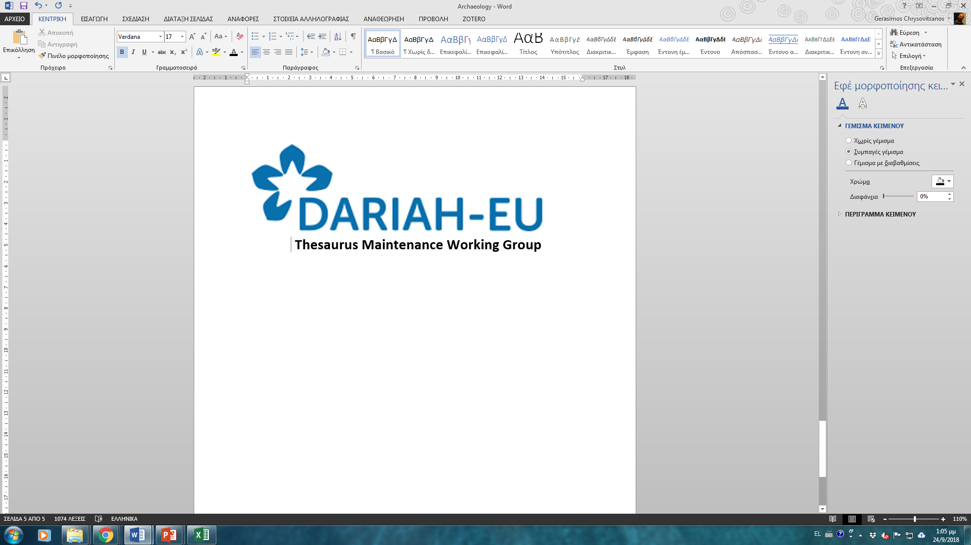
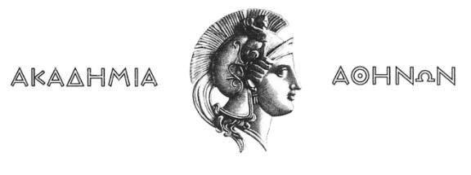


A web of thesauri: Aligning specialist thesauri to the Backbone
Thesaurus
Thesaurus Maintenance WG meeting
Helen Goulis (AΑ), Eleni Tsoulouha (ICS-FORTH)
Thesaurus Maintenance WG
Warsaw annual event, 17/05/19

Slide 2

Activities recap:
Launch of the BBtalk tool (June, 2018)
Ensuring communication of the BBT browser and the Submission management tools (ACDH Vocabulary Repository Service and and BBTalk)
Workshop in September (28/9/2018, Herakleion, Crete)
Activation of BBT curating committee
Translations of the BBT facets and top terms (French, German language)

Slide 3
Our goals have been to:
Establish an overarching metathesaurus for the Humanities
Identify the top-level-concepts (facets and hierarchies) that will become its common basis, meeting the demands for objectivity and interdisciplinarity
Define the essential properties of the general concepts in order to render the classification consistent and objective
Facilitate sustainable and manageable expansion of the thesauri into new areas of knowledge)

Slide 4
Thesaurus Maintenance WG
A semantic approach
A bottom-up, recursively applied semantics of intensions forms the theoretical background that determines the top-level concepts necessary for building coherent, consistent and interoperable thesauri.
The semantic approach helps select the appropriate primitive concepts (facets), which correspond to general categories of the way we perceive reality (Person, Matter, Activity, etc.)
In this context we search for the intensional properties of the terms.

Slide 5
Bottom-up method
Clearly defined relationships between the top-level concepts and the terms emerging from each specific field guarantees the preservation of the specific meaning of each term.
The bottom-up method selects and defines the top-level concepts which are suitable enough to cover the requirements within each classification system.
The interactive relationship between the terms and the top-level concepts helps uncover any shortcomings with respect to the hierarchies and the facets proposed
It’s possible that upon extending the domain of application of a thesaurus, the need for new hierarchies will arise –but changes should be motivated.

Slide 6
Benefits of the faceted classification:
Reveals the complexity of a term and reduces it to its fundamental components.
It is not an artificial classification of the terms or a “top down” classification, but is generated from the analysis/decomposition of one term in its elementary characteristics.
A term can be classified in multiple hierarchies (e.g. doll toys/visual works).
Is independent of the context, within which each a term appears although the context is crucial for the classification of a term in facets.
Is based only in a restricted number of fundamental concepts.
Can be expanded without disrupting or disorganizing existing facets and hierarchies and enables thus compatibility between different classification systems from different domains without imposing terms on the experts.
It does not presuppose knowledge regarding the exact context of the terms.

Slide 7
Tools and services developed:
Site www.backbonethesaurus.eu
BBTalk online editing and communication tool between the curators of the BBT and its users
BBT-Browser & Federated Thesauri Viewer
the online access service allowing users to navigate through the
concepts and hierarchies of the BBT and the thesauri connected to it

Slide 8
Cases
Use cases of alignment of local thesauri to the BBT.
The Parthenos case
The Pactols case

Slide 9
Next steps
Increase the impact of our work/joint projects, leading to greater dissemination
New collaborations (open invitation to thesauri holders)/partners
Tidying up: Validating the classification through integration to be completed till the
Workshop on BBT content and curation in Athens, Autumn 2019

Slide 10
Thesaurus Maintenance WG
Academy of Athens (AA)
Berlin-Brandenburgische Akademie der Wissenschaften (BBAW)
Centre national de la recherche scientifique (CNRS)
Deutsches Archäologisches Institut (DAINST)
Digital Curation Unit of the Institute for the Management of Information Systems in Athens (DCU)
Foundation for Research and Technology-Hellas (FORTH)
Herzog August Bibliothek (HAB)
Leibniz Institut für Europäische Geschichte Mainz (IEGMAINZ)
Österreichische Akademie der Wissenschaften (OEAW)
Società internationale per lo studio del Medioevo Latino SISMEL
Staats und Universitäts- Bibliothek Göttingen (SUB.UNIGOETTINGEN)
Université catholique de Louvain (UCLOUVAIN)

